Slide 1
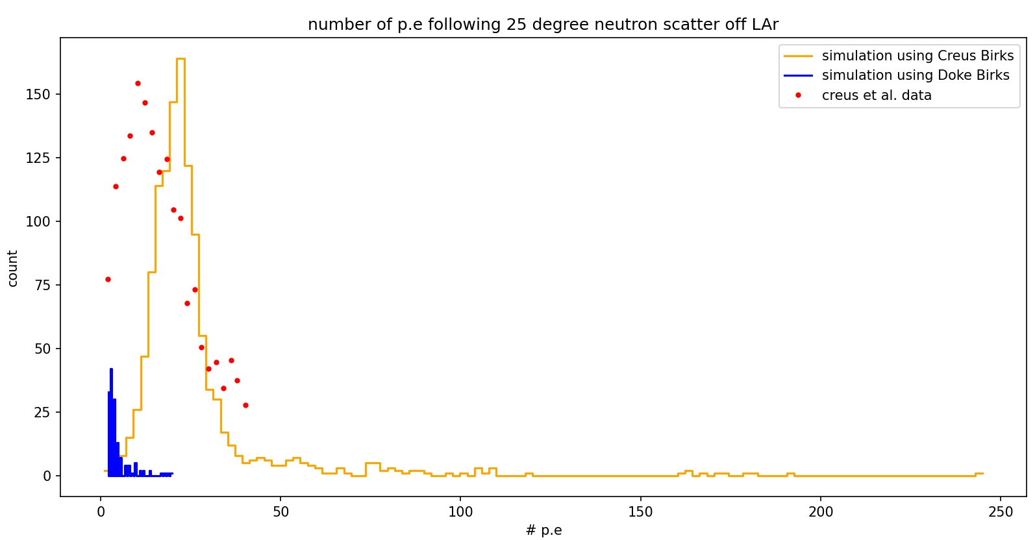
Idea: Calibrate Geant4 optical photon simulation using Creus et al. data
Notes:
So far we have validated our simulation’s energy deposit vs data taken by Creus et al.
Now we wish to calibrate our simulation’s scintillation in LAr based on their data.
We see that when we use Birk’s constant extracted by using Doke et al., NIMA 269, (1988) 291-296 , or the one used by Creus et al. , there is a mismatch in the number of photoelectrons detected.

Slide 2
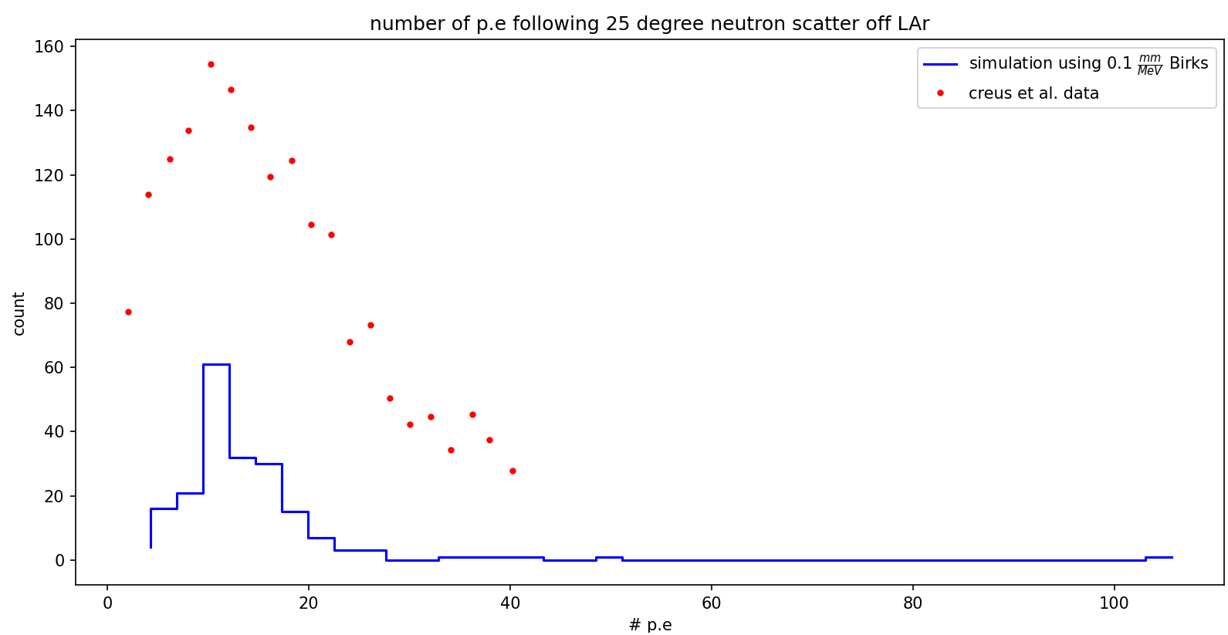
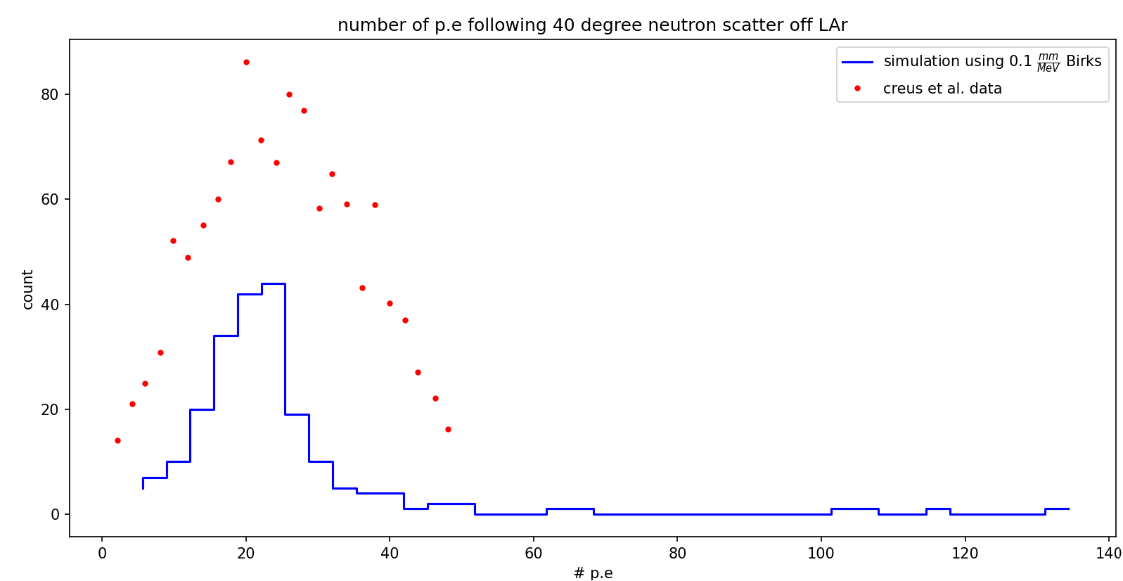
Notes:
Thus, we want to try and find a Birk’s constant which will yield matching results with Creus et al. data.
Note that they used a logarithmic binning method on their data, but for now we will not attempt to replicate this.
By setting Birk’s constant to be $0.1\frac{mm}{MeV}$ , we see a good match in photoelectron numbers following 25,40 degree neutron scattering angles, except that the data has a much wider distribution. This is possibly due to neutron beam energy not being exactly monochromatic, or maybe neutron beam solid angle, though this should be account for. Alternatively, the parameter which sets the gaussian std could be wrong.

Slide 3
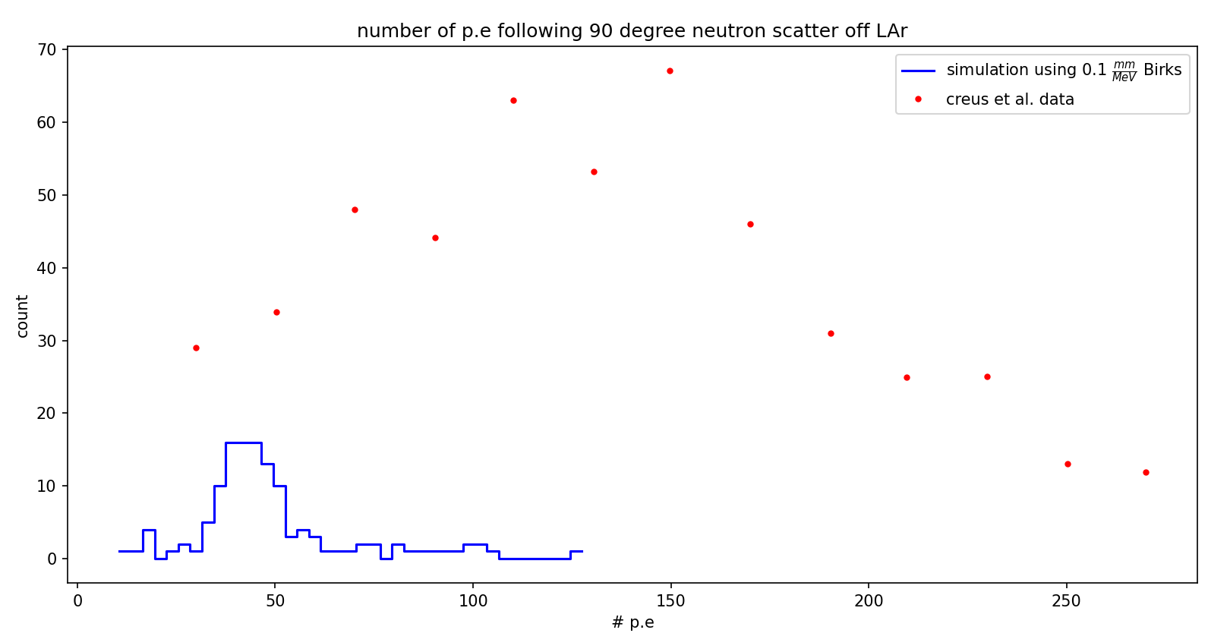
The 90 degree scattering angle simulation is however at very bad disagreement with the data.
Notes:
I am not sure why this is the case. Perhaps we do need to use the logarithmic binning method, which should skew all distributions towards higher photoelectron amount, and might affect larger scattering angles more so than smaller scattering angles.

Slide 4
To be pedantic, we will also change the current method of tracking time of flight within the simulation, which relies on interaction vertex timing within the detectors, into a more experimental method, by using the optical photons signal from the detectors, although this might not change the results.

Slide 5
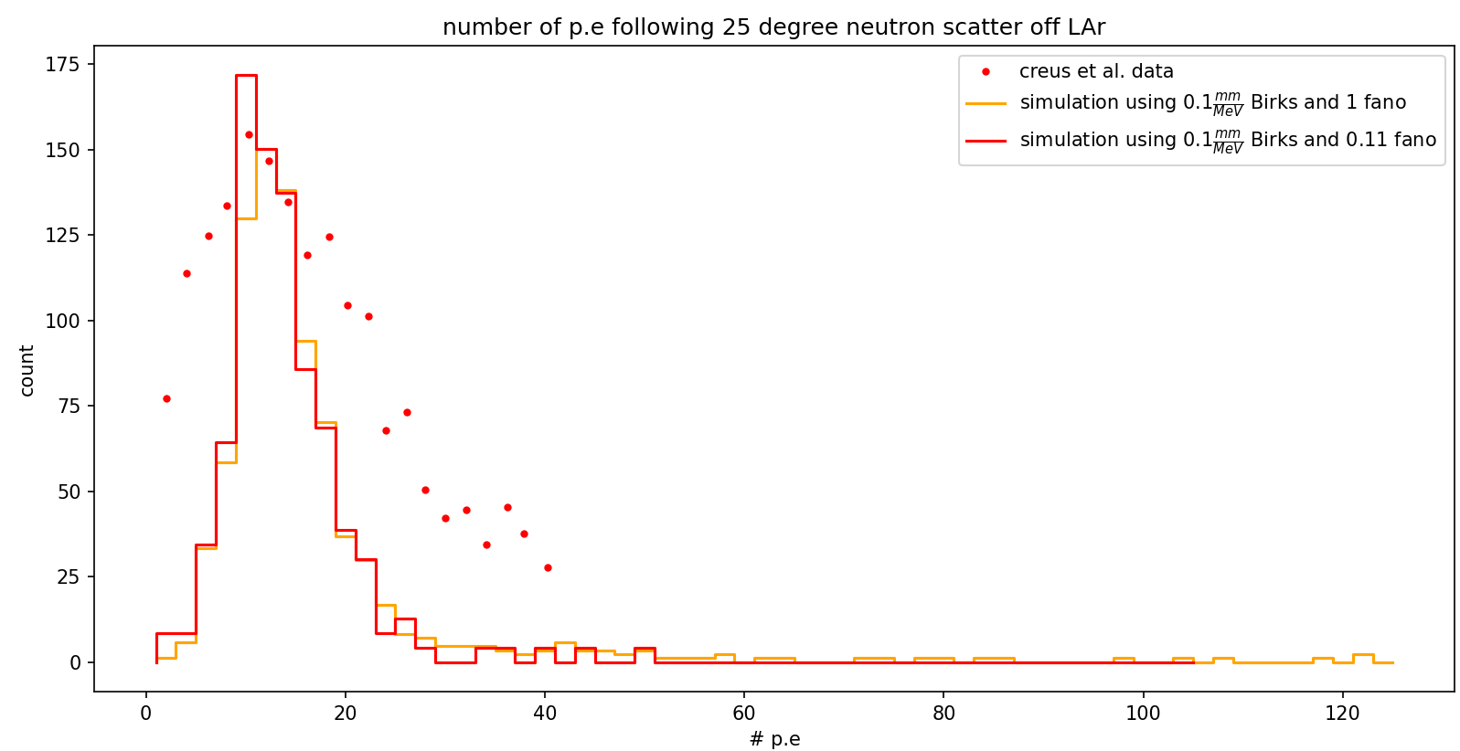
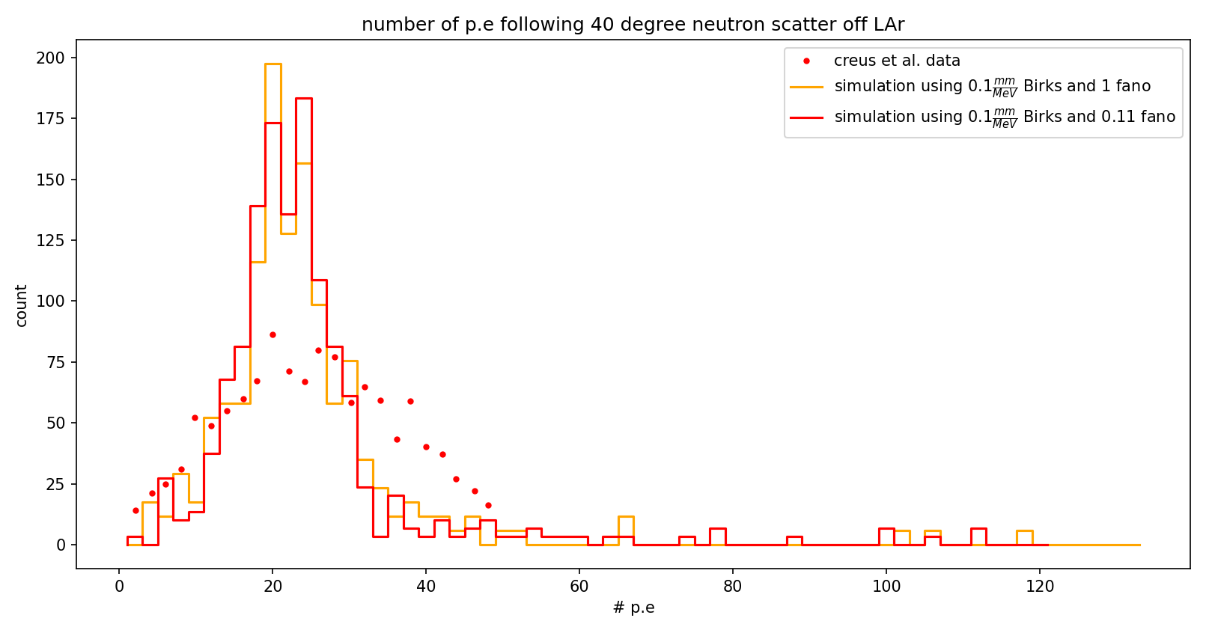
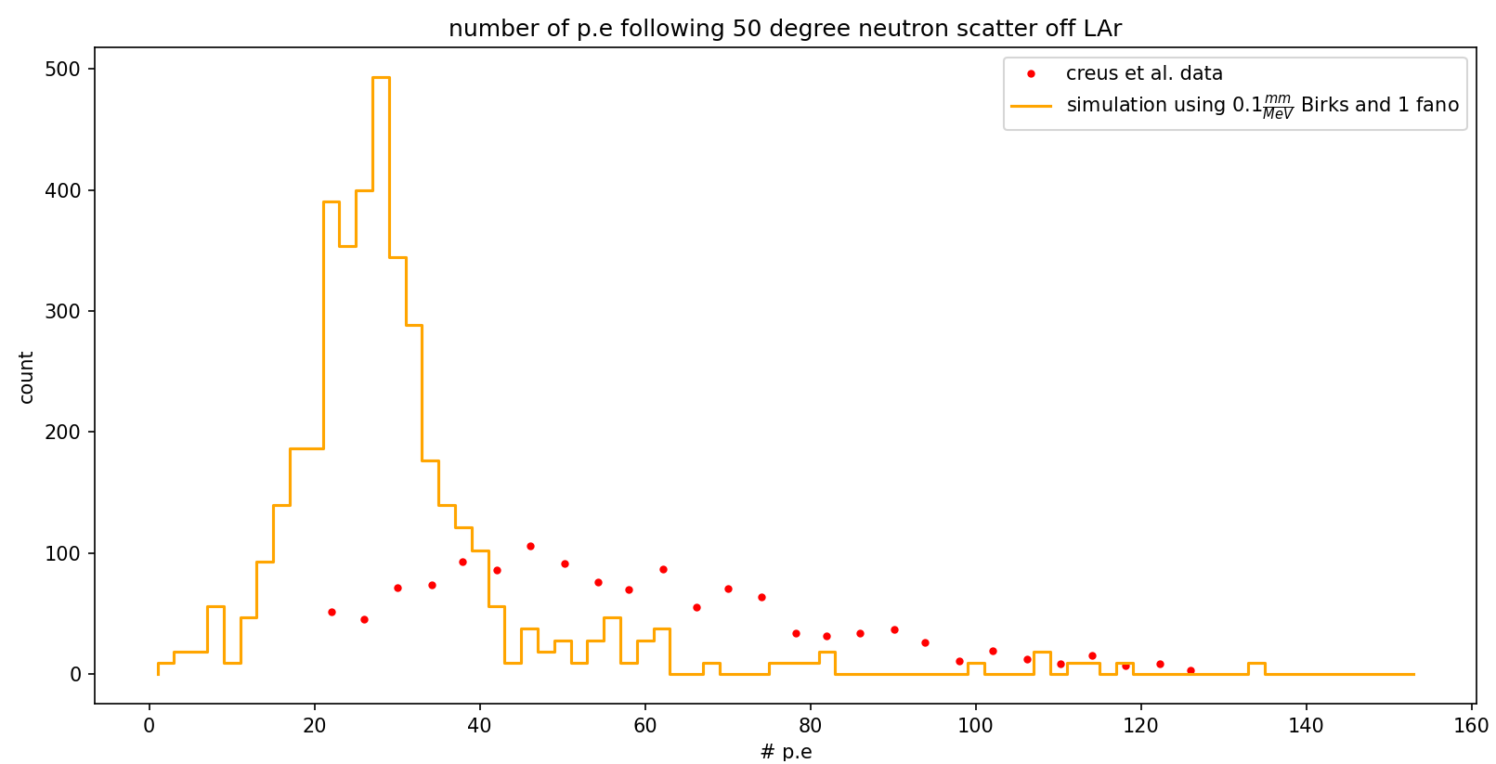
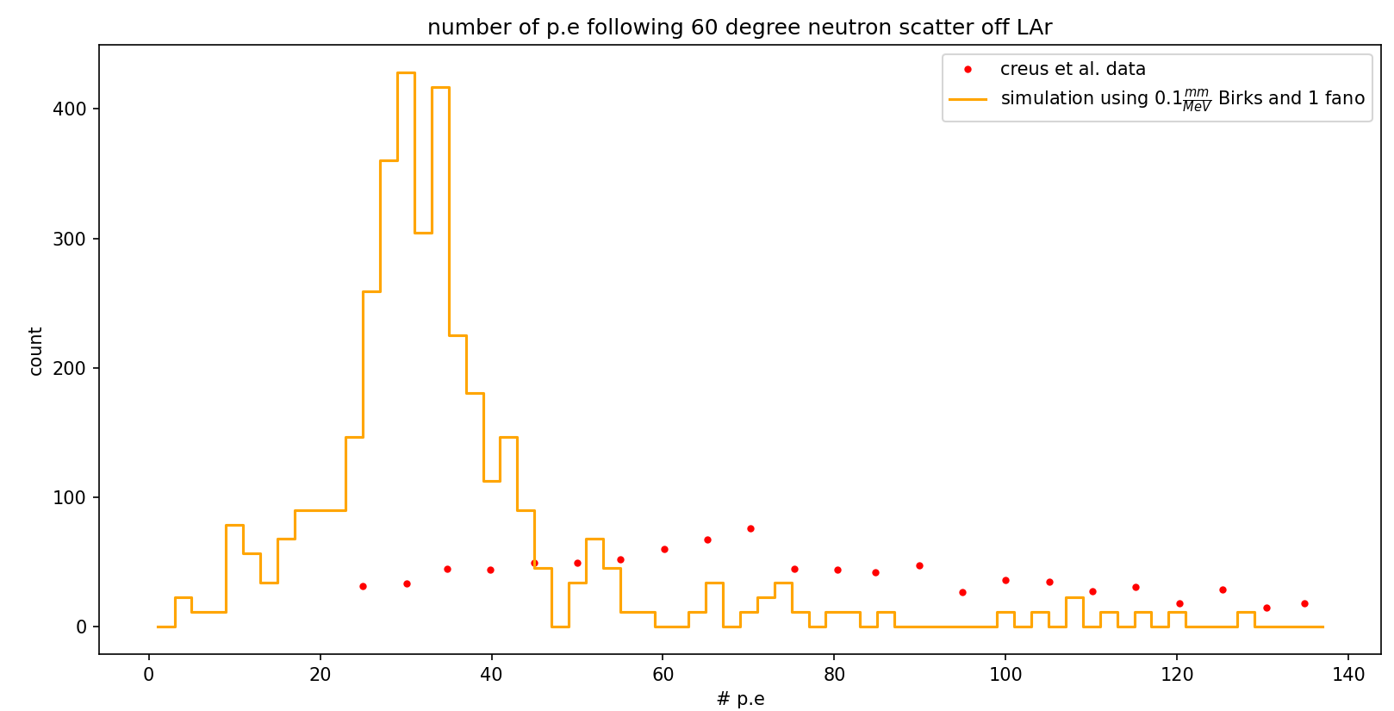

Slide 6
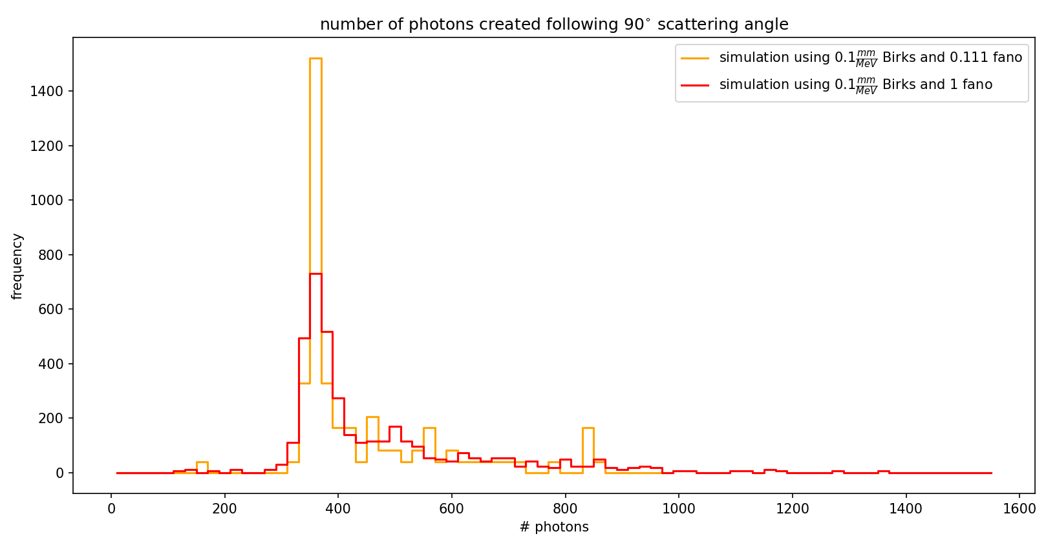
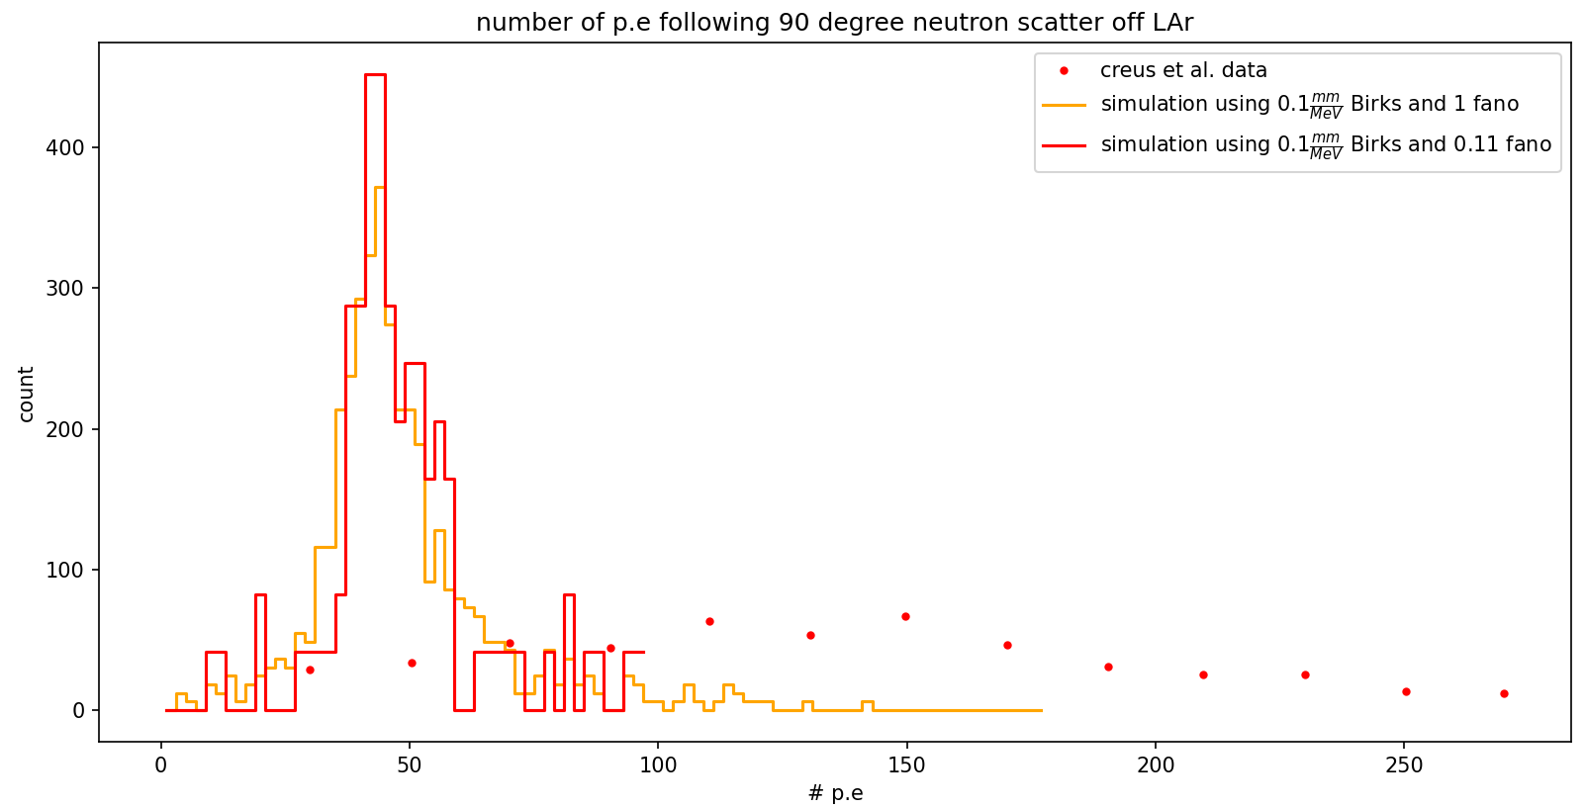
As it seems fano factor does widen the distribution, but mostly around the tails, so it can’t explain creus data behaviour

Slide 7
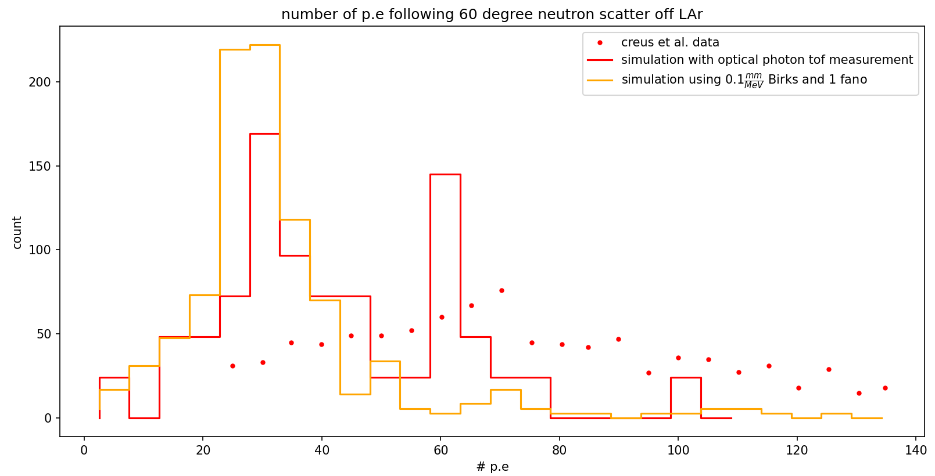
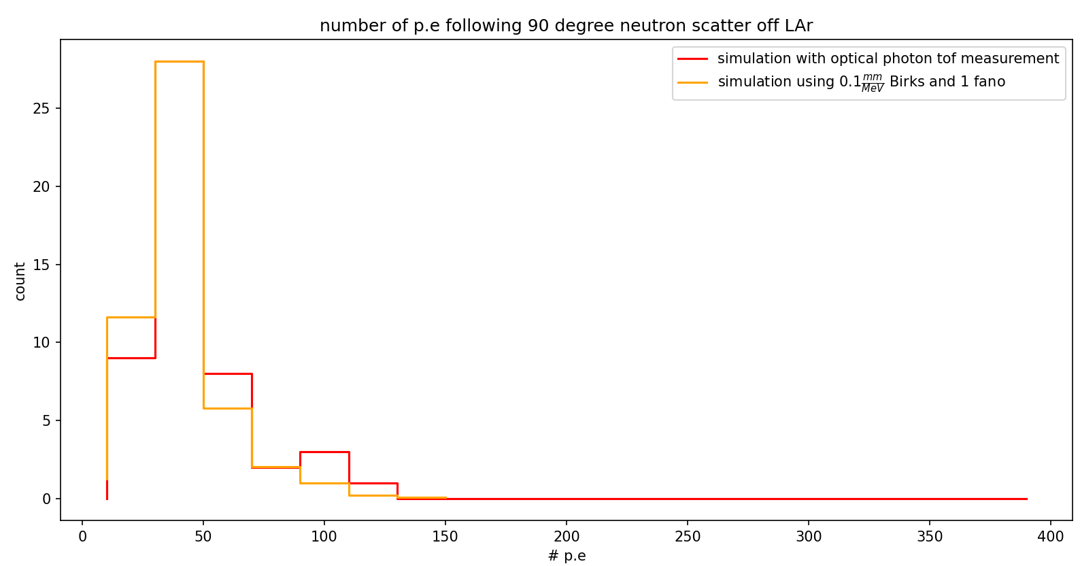
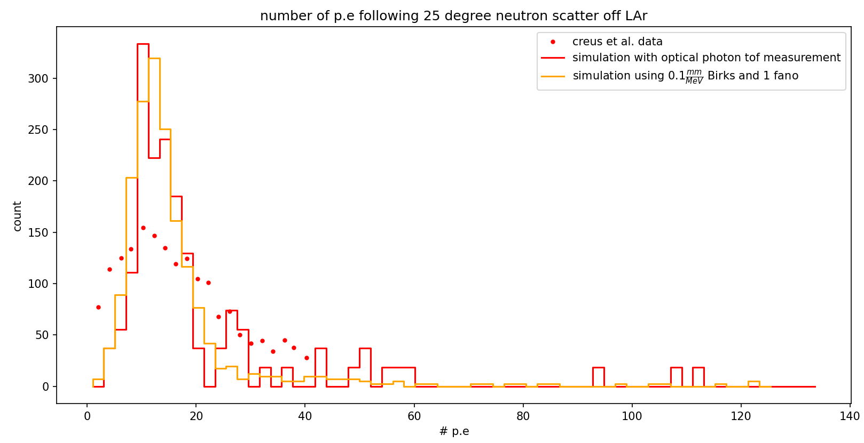

Slide 8
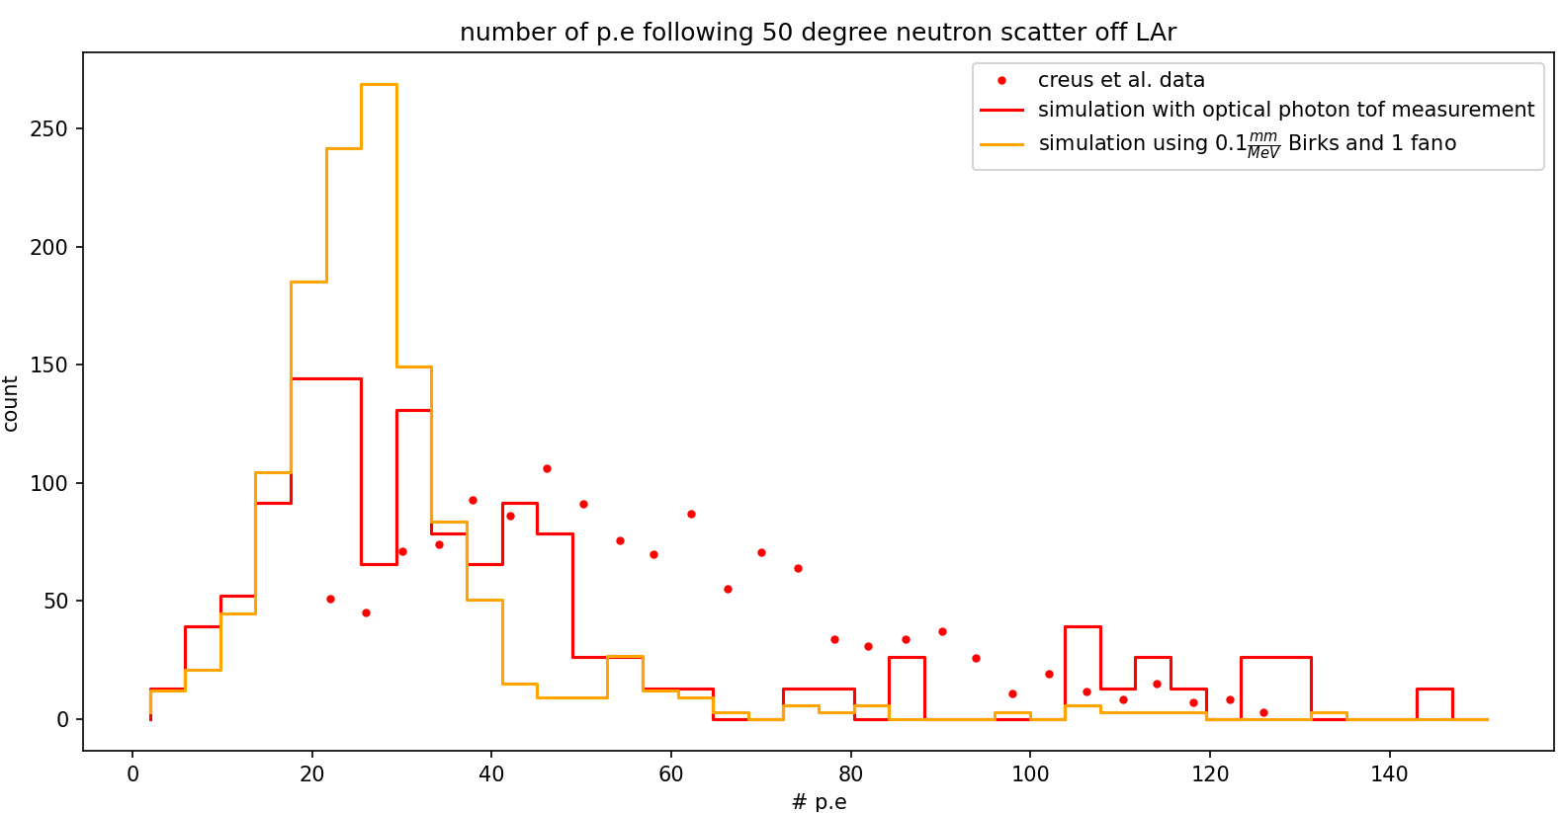
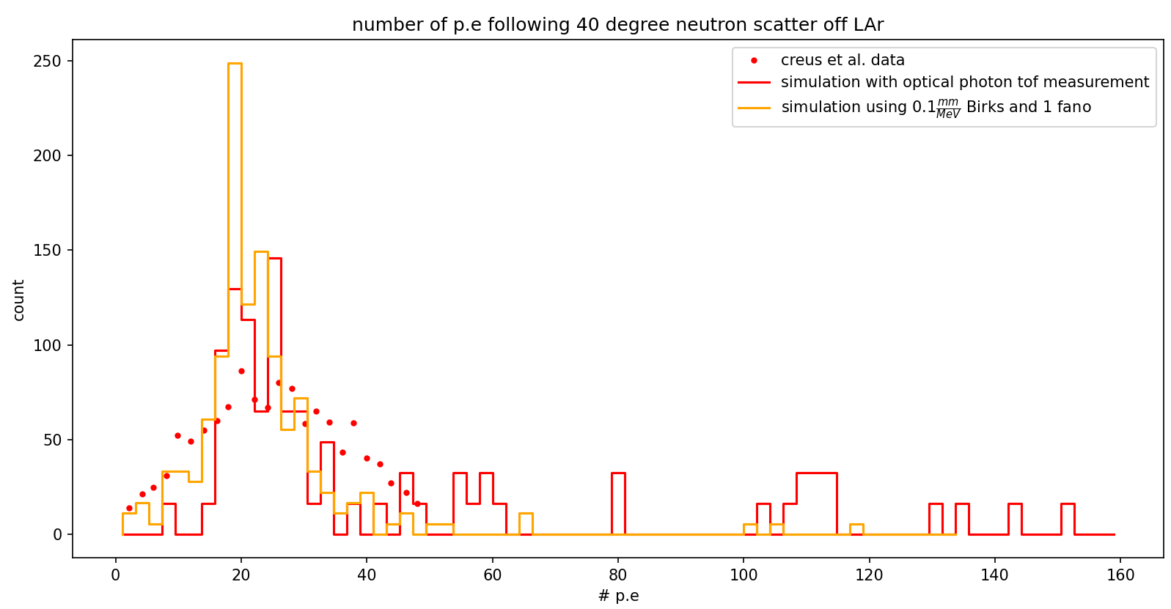

Slide 9
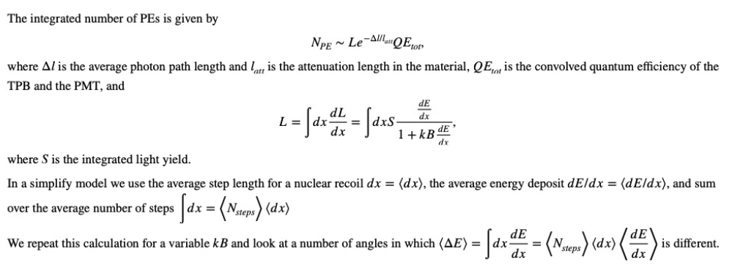
In order to correct for the discrepancy between my simulation and Creus’ data, We will try using a simplified model to find the QE and Birk’s constant which will yield similar results to the data.

Slide 10
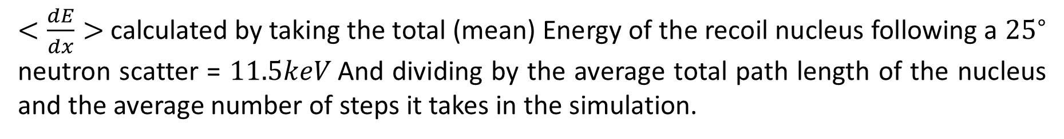
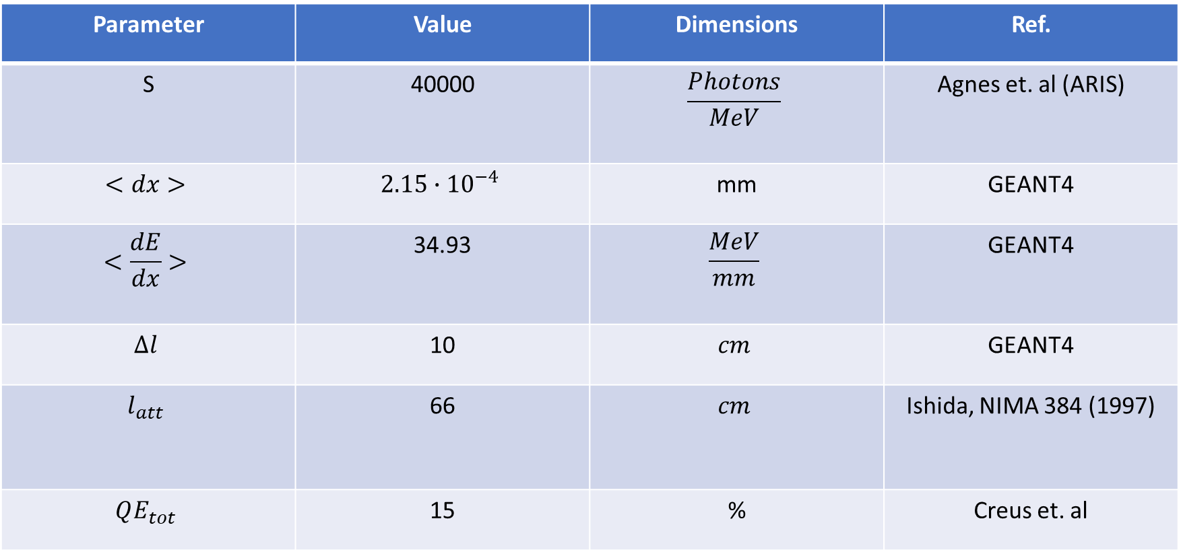
$<\frac{dE}{dx}>$ calculated by taking the total (mean) Energy of the recoil nucleus following a ${25}^{∘}$ neutron scatter = $11.5keV$And dividing by the average total path length of the nucleus and the average number of steps it takes in the simulation.
Parameter | Value | Dimensions | Ref.
S | 40000 | $$\frac{Photons}{MeV}$$ | Agnes et. al (ARIS)
$$<dx>$$ | $$2.15∙{10}^{−4}$$ | mm | GEANT4
$$<\frac{dE}{dx}>$$ | 34.93 | $$\frac{MeV}{mm}$$ | GEANT4
$$Δl$$ | 10 | $$cm$$ | GEANT4
$$l_{att}$$ | 66 | $$cm$$ | Ishida, NIMA 384 (1997)
$$QE_{tot}$$ | 15 | % | Creus et. al

Slide 11
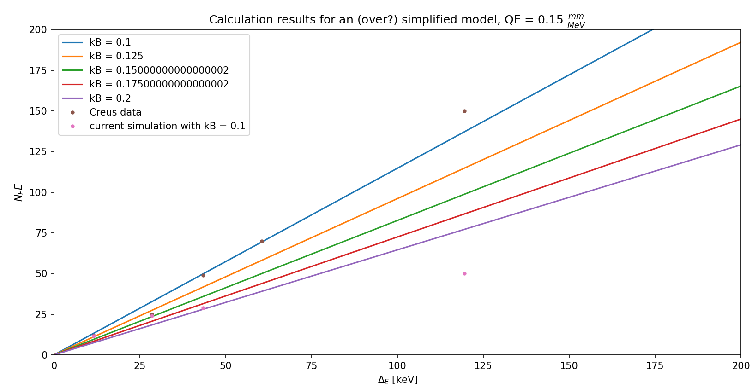
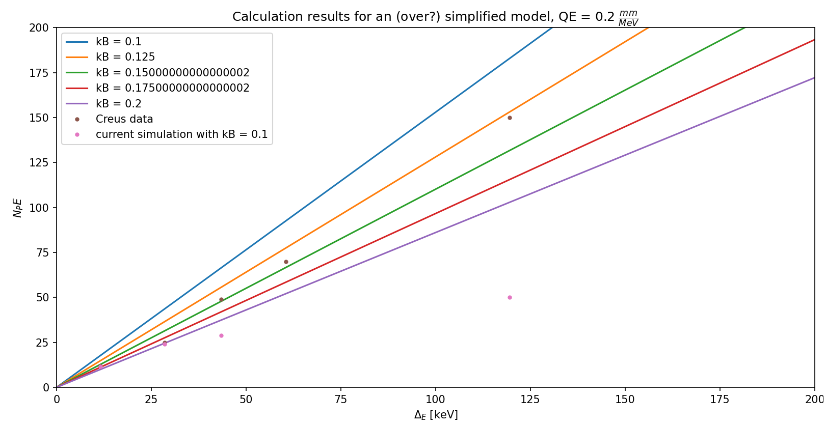
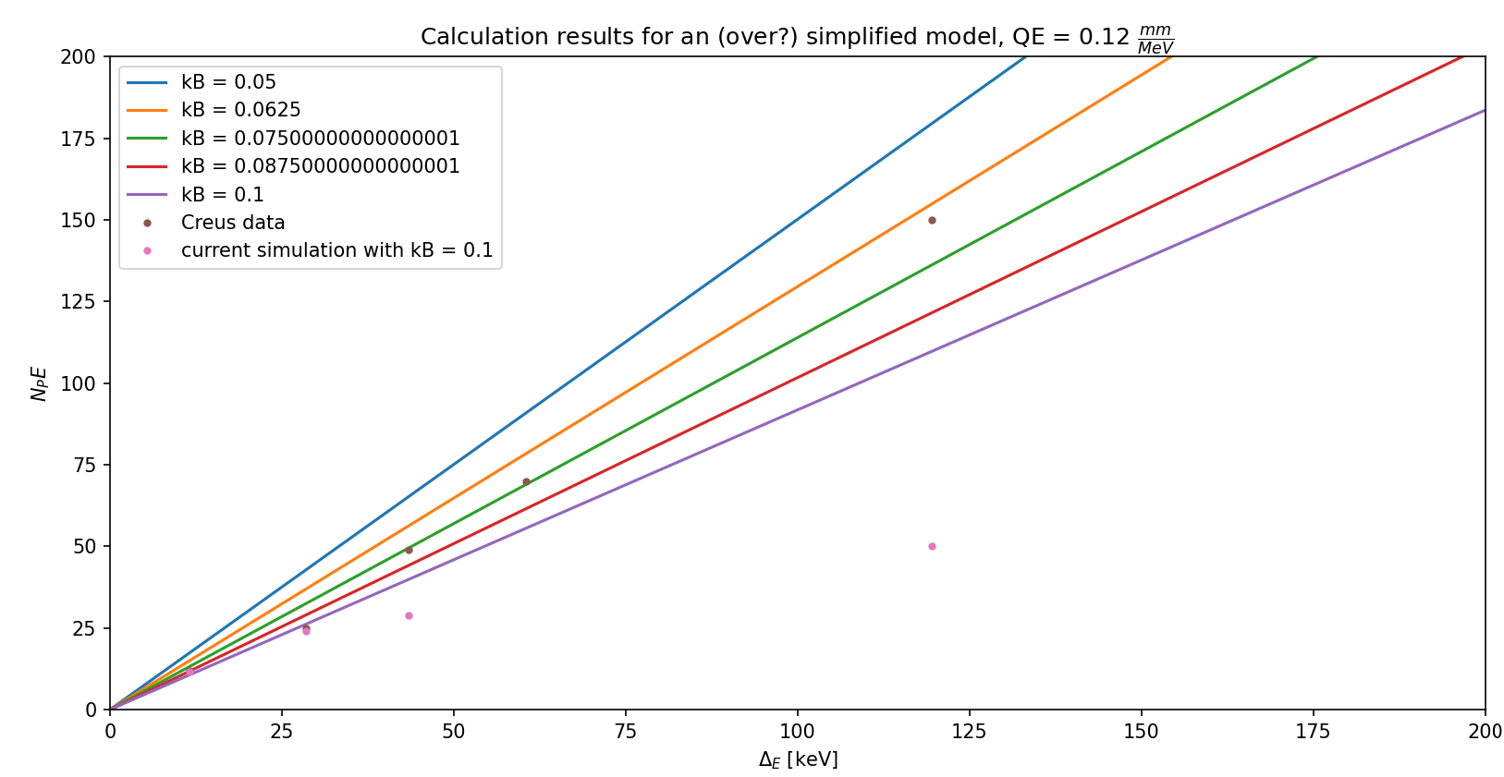

Slide 12
After many attempts we decided to ditch Creus’ work for now, and focus on two other works – one is the Darkside detector and the other is the ARIS collaboration.
We start by fitting our simulation results to their gamma ray data by manipulating Birk’s constant and the optical photon attenuation length in LAr.

Slide 13
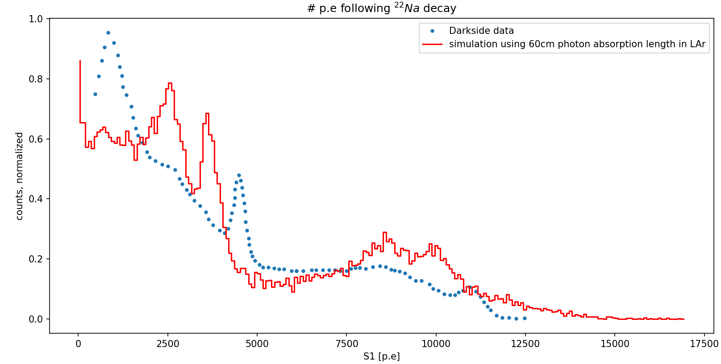
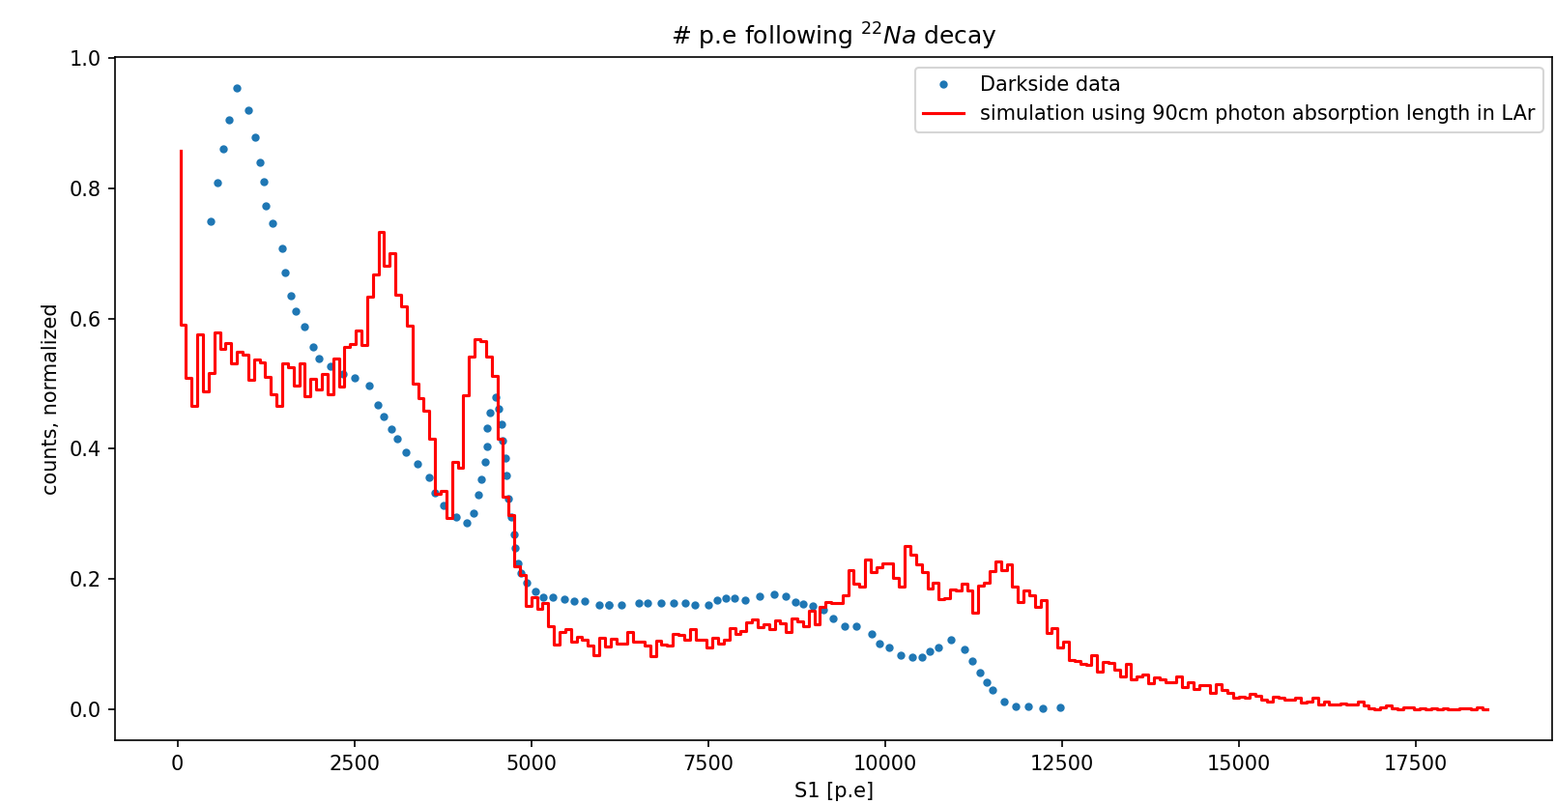
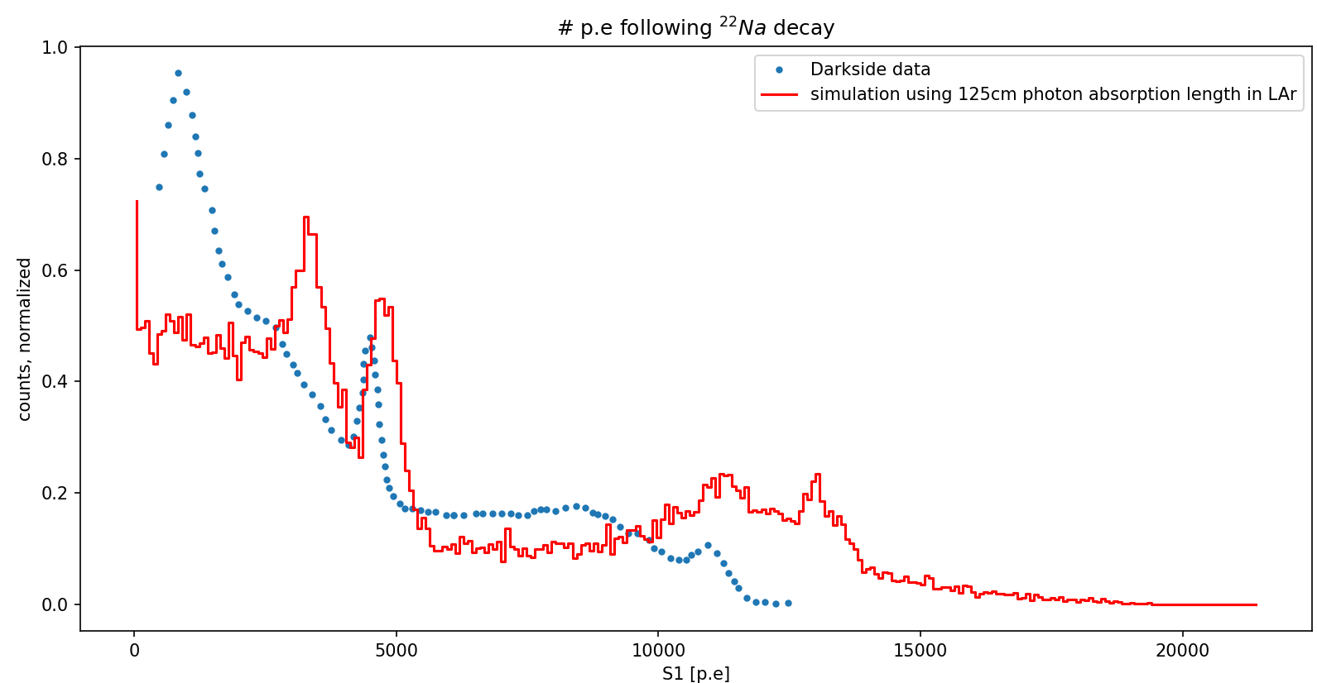

Slide 14
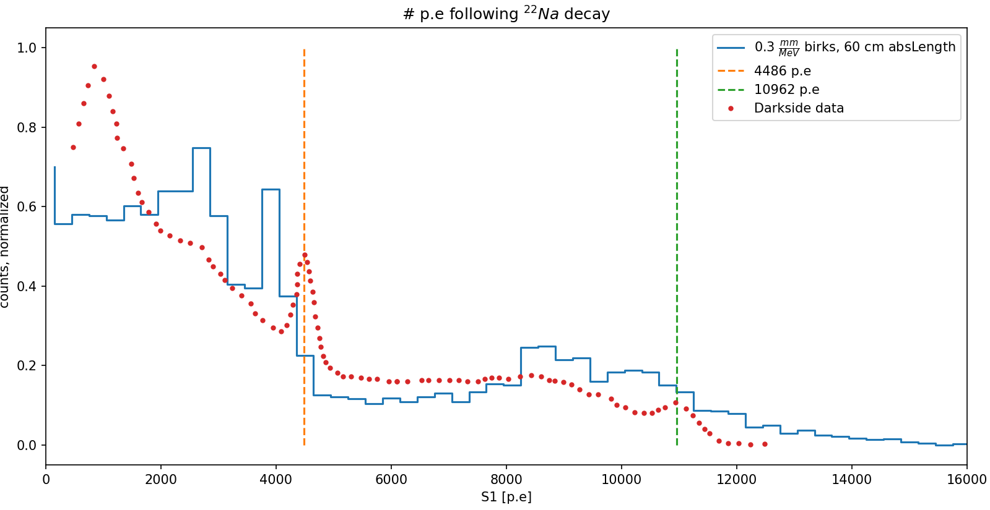
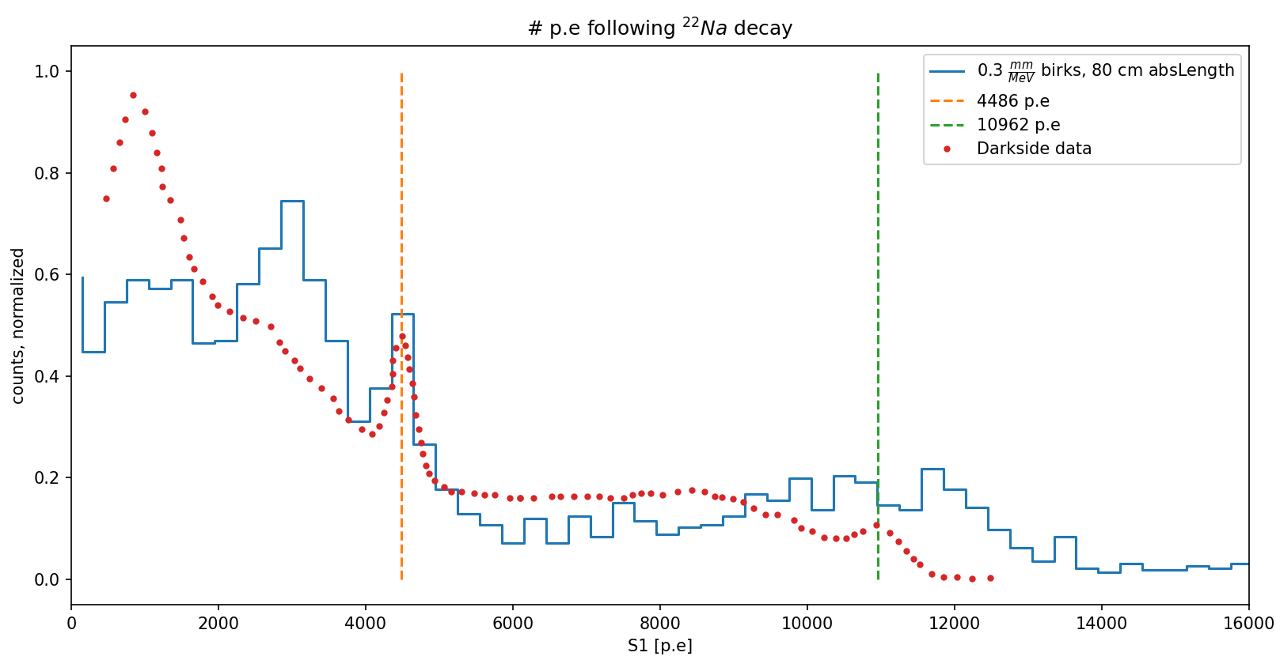
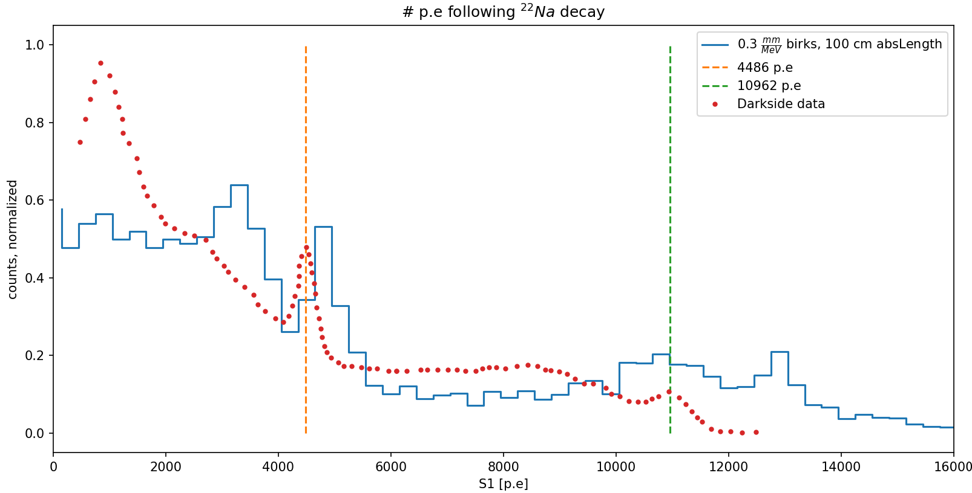
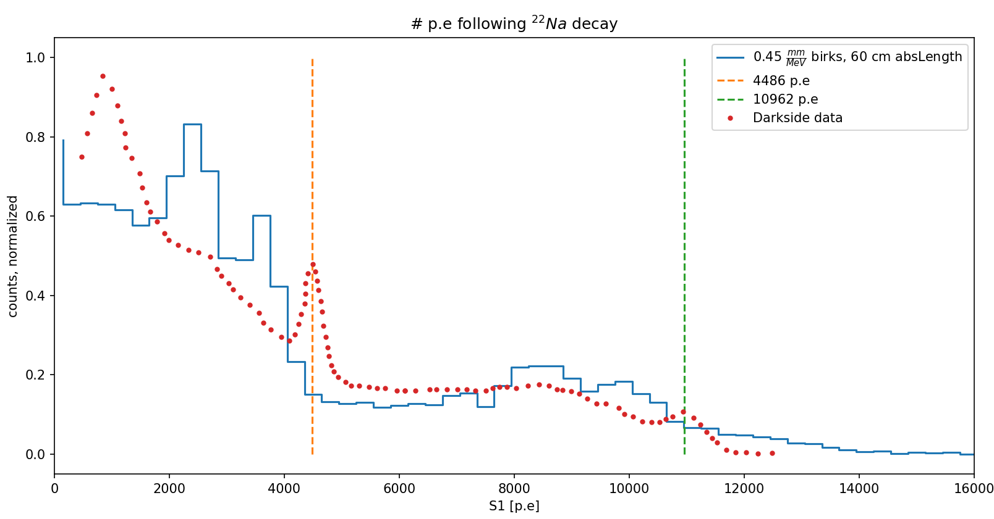
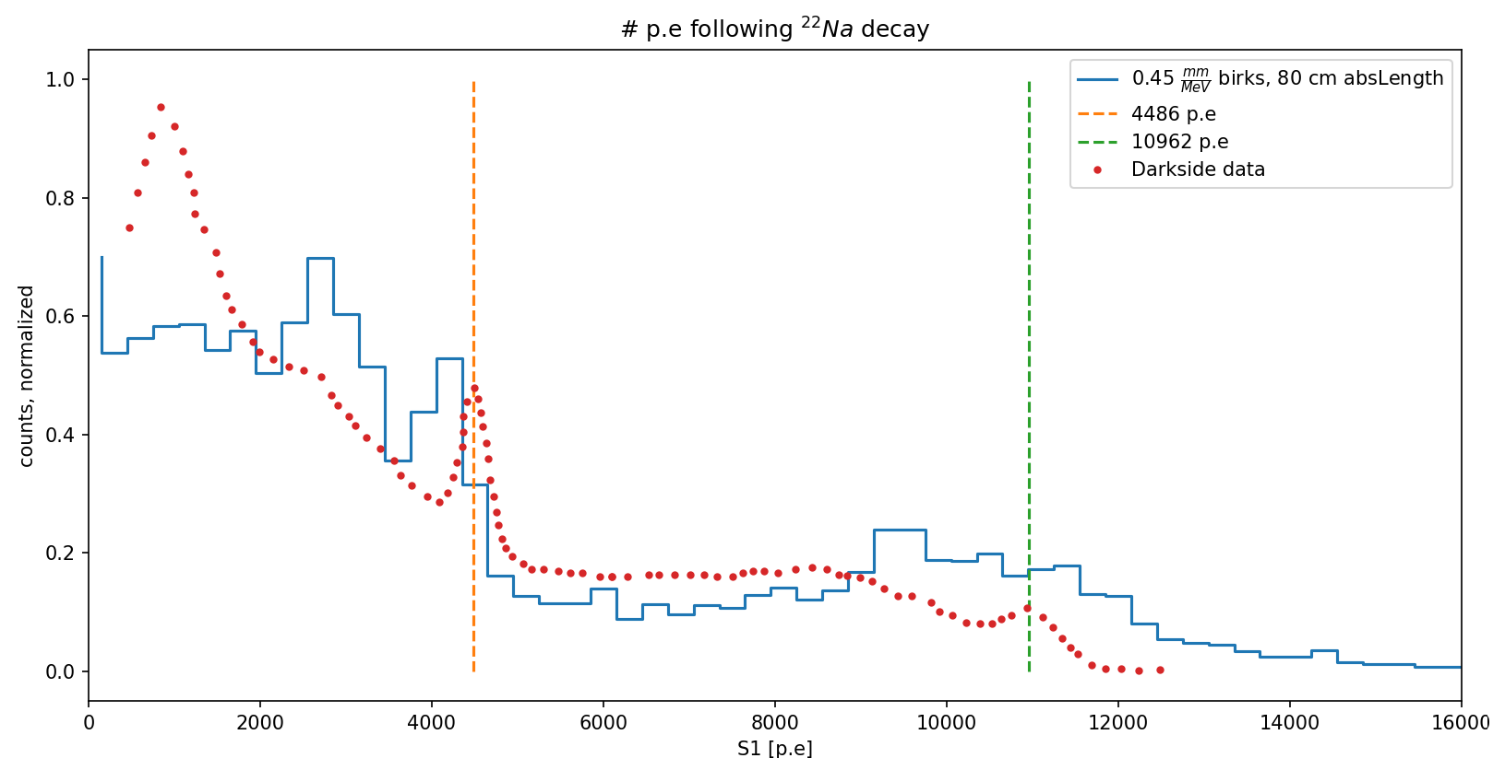
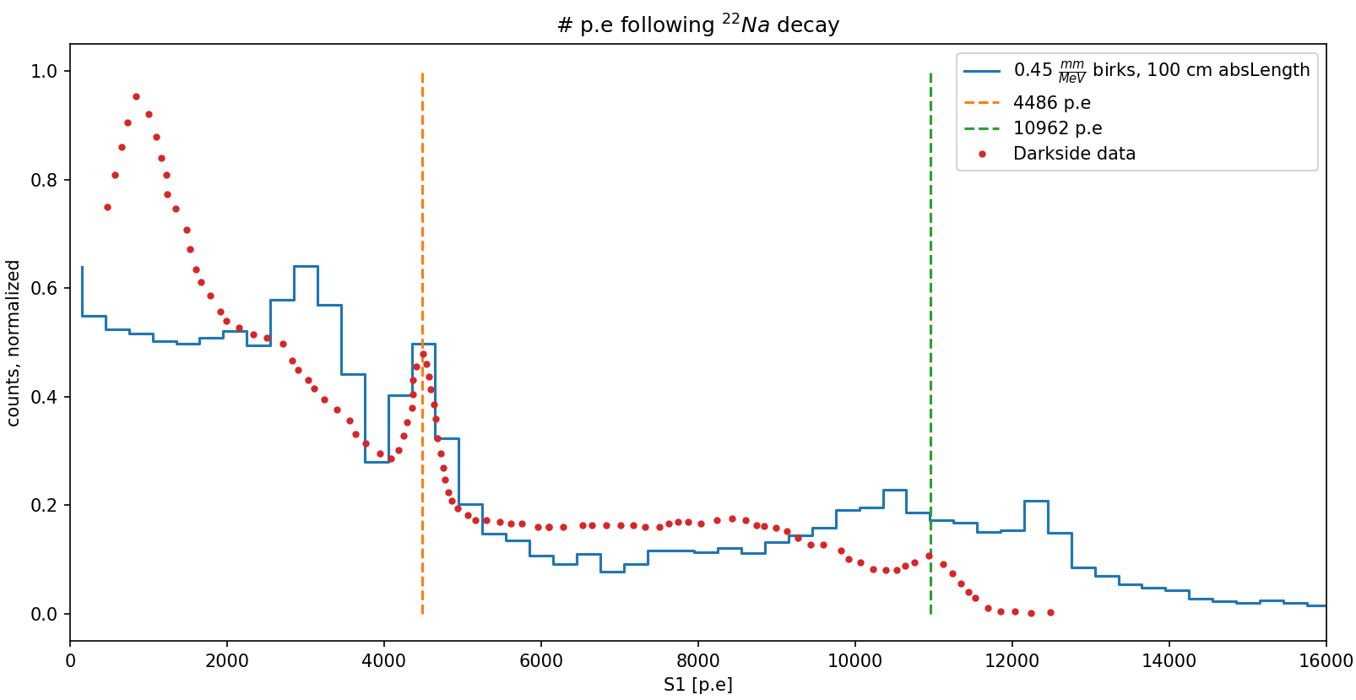
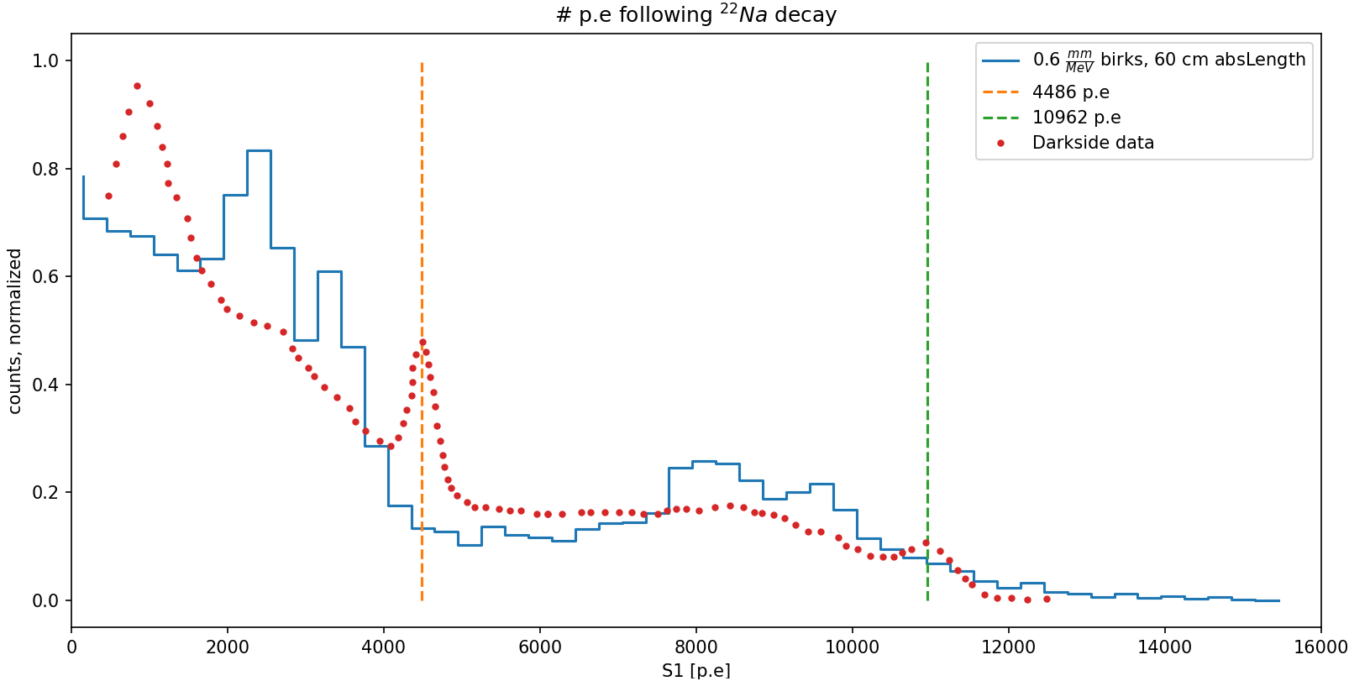
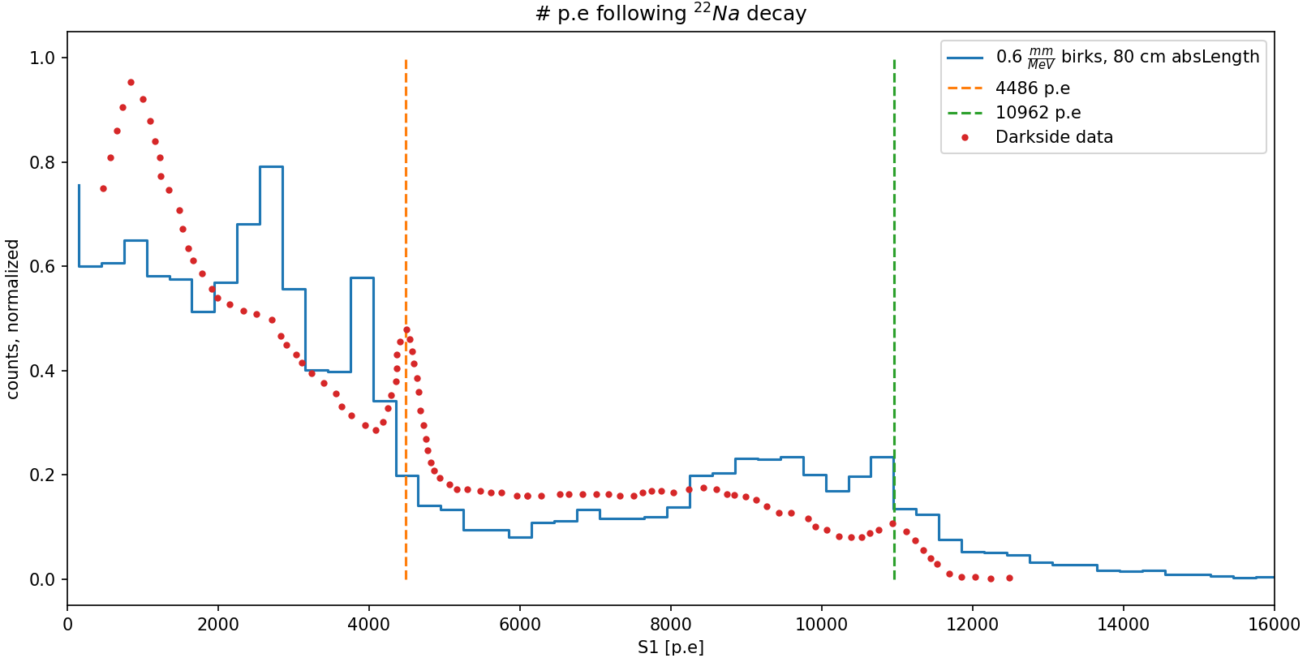
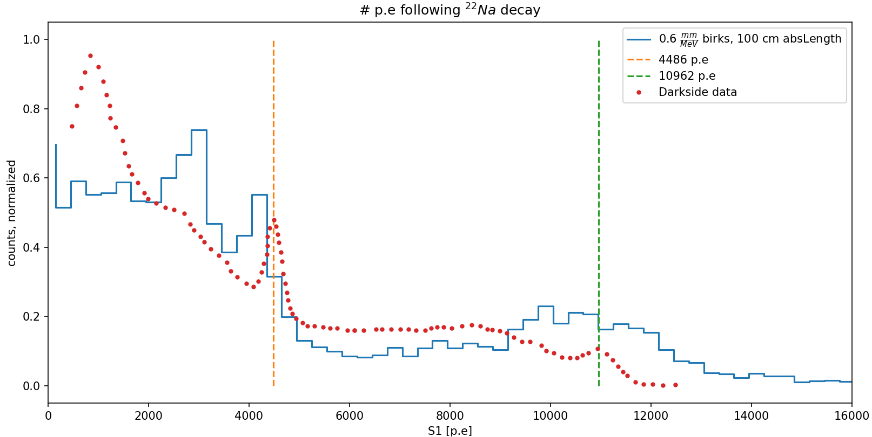

Slide 15
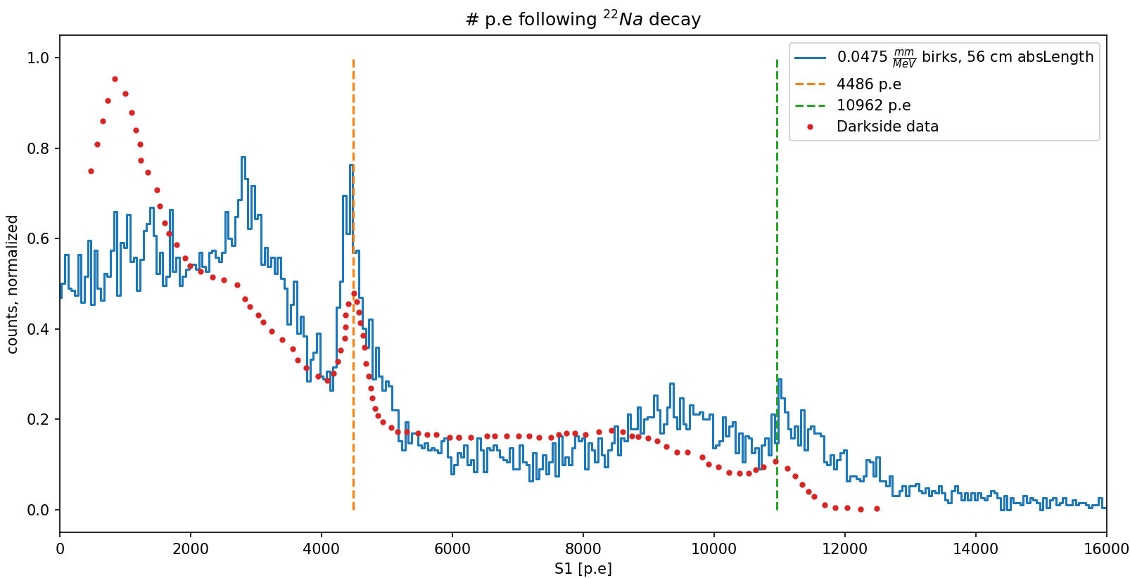

Slide 16
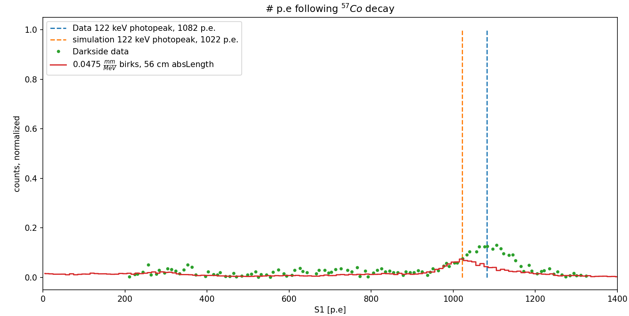
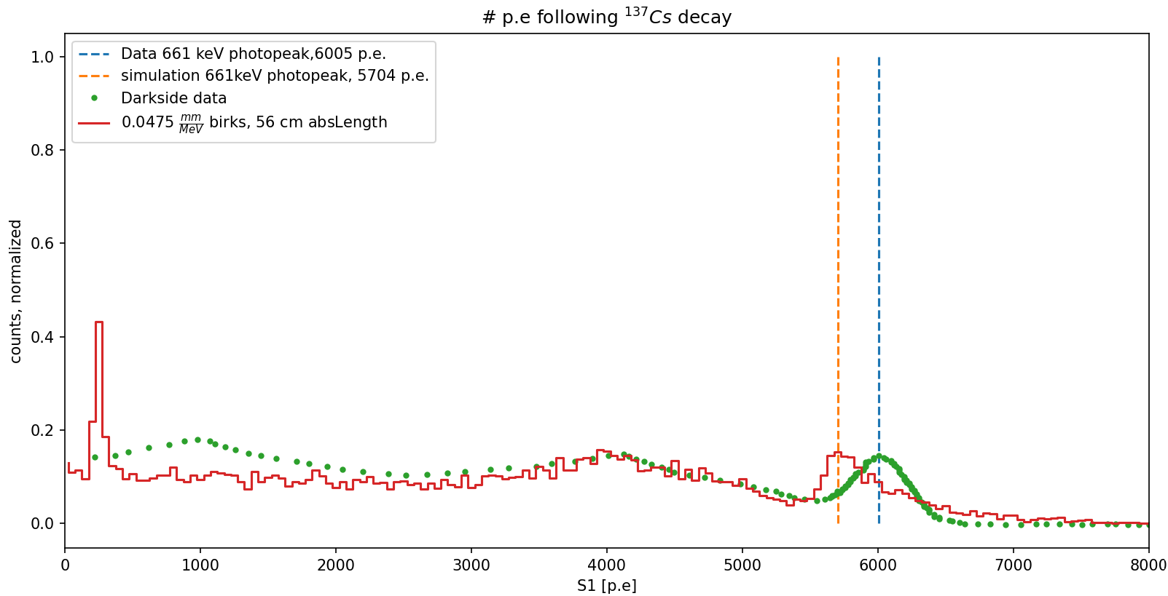
In both cases we see a discrepancy of about 5% between simulation and data using the same parameters we found for the Na data. This is explained by the authors of the paper -

Slide 17
OOPS
Forgot to take into account TPB conversion efficiency – thought it was ~1 for some reason. Literature survey was required and took some time but the results are summarized in the next slide table

Slide 18
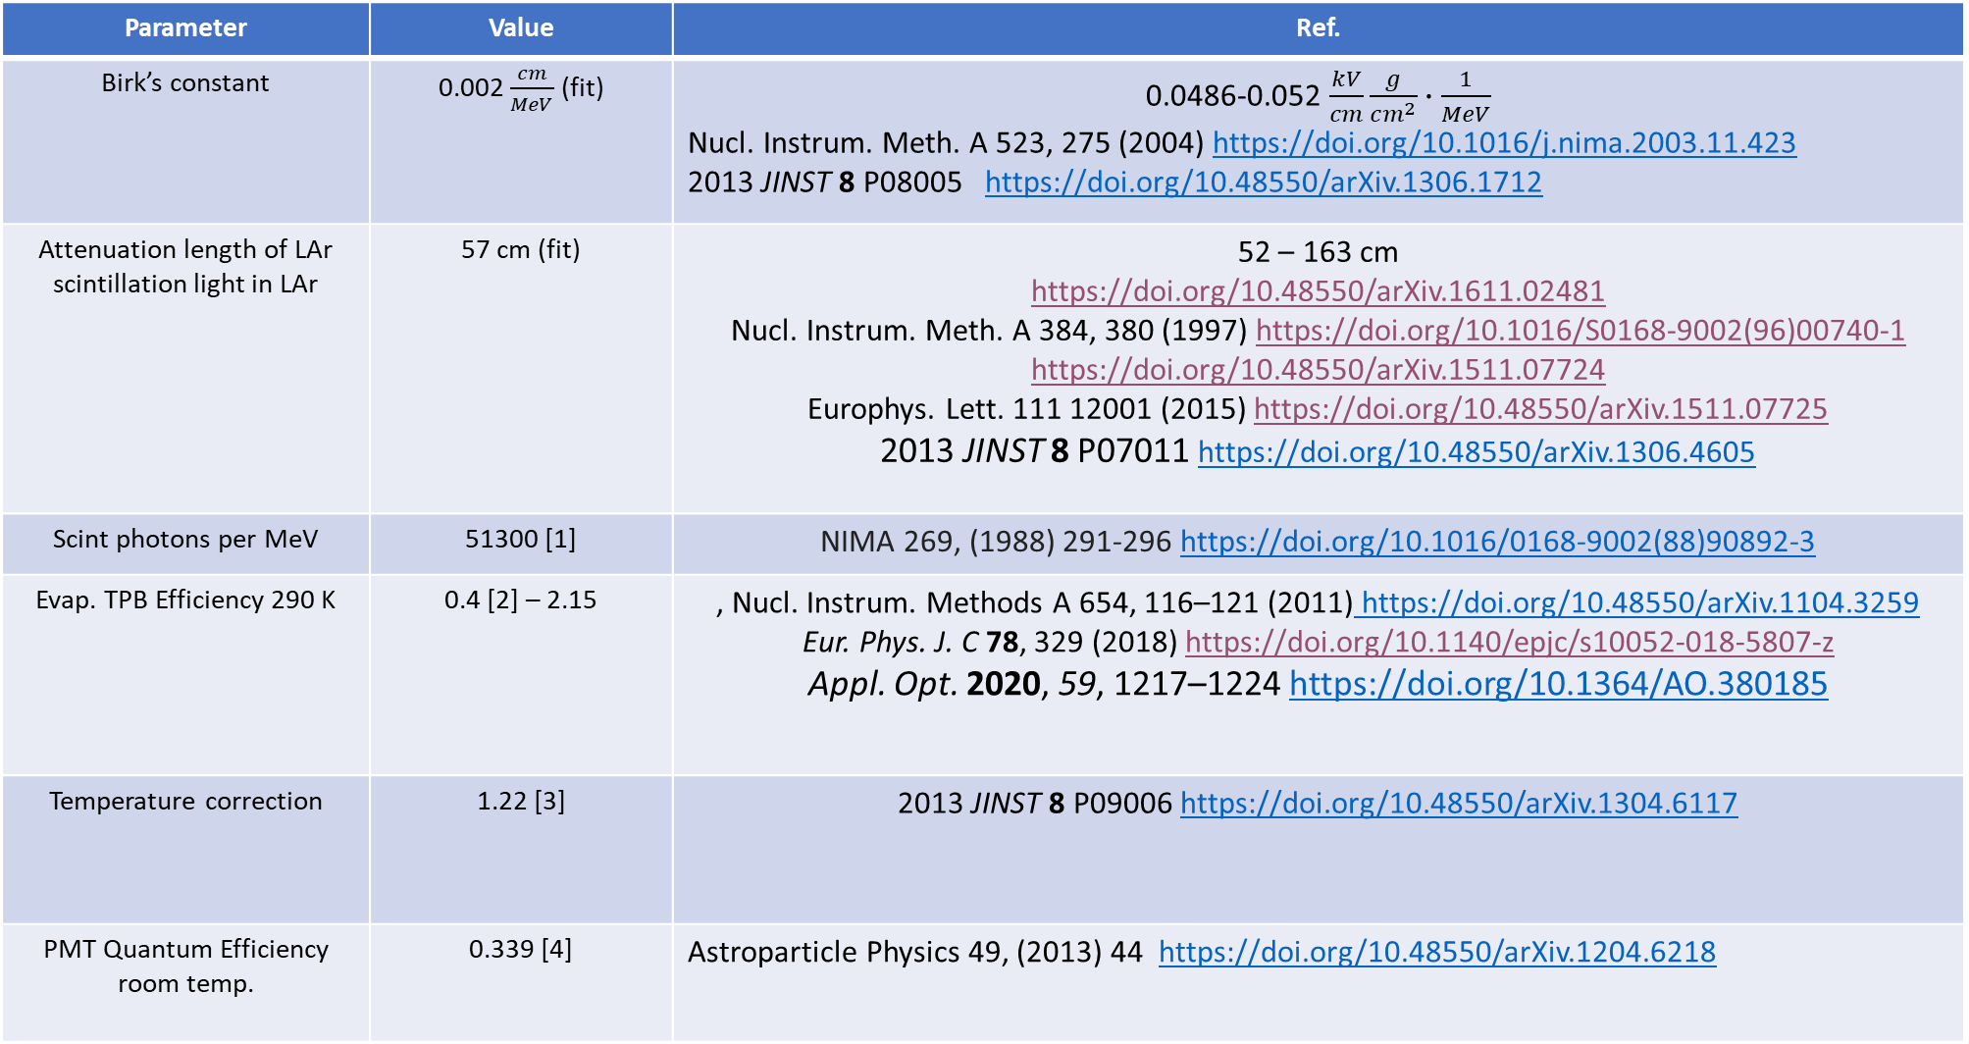
Parameter | Value | Ref.
Birk’s constant | 0.002 $\frac{cm}{MeV}$ (fit) | 0.0486-0.052 $\frac{kV}{cm}\frac{g}{cm^{2}}∙\frac{1}{MeV}$ Nucl. Instrum. Meth. A 523, 275 (2004) https://doi.org/10.1016/j.nima.2003.11.423 2013 JINST 8 P08005 https://doi.org/10.48550/arXiv.1306.1712
Attenuation length of LAr scintillation light in LAr | 57 cm (fit) | 52 – 163 cm https://doi.org/10.48550/arXiv.1611.02481 Nucl. Instrum. Meth. A 384, 380 (1997) https://doi.org/10.1016/S0168-9002(96)00740-1 https://doi.org/10.48550/arXiv.1511.07724 Europhys. Lett. 111 12001 (2015) https://doi.org/10.48550/arXiv.1511.07725 2013 JINST 8 P07011 https://doi.org/10.48550/arXiv.1306.4605
Scint photons per MeV | 51300 [1] | NIMA 269, (1988) 291-296 https://doi.org/10.1016/0168-9002(88)90892-3
Evap. TPB Efficiency 290 K | 0.4 [2] – 2.15 | , Nucl. Instrum. Methods A 654, 116–121 (2011) https://doi.org/10.48550/arXiv.1104.3259 Eur. Phys. J. C 78, 329 (2018) https://doi.org/10.1140/epjc/s10052-018-5807-z Appl. Opt. 2020, 59, 1217–1224 https://doi.org/10.1364/AO.380185
Temperature correction | 1.22 [3] | 2013 JINST 8 P09006 https://doi.org/10.48550/arXiv.1304.6117
PMT Quantum Efficiency room temp. | 0.339 [4] | Astroparticle Physics 49, (2013) 44 https://doi.org/10.48550/arXiv.1204.6218

Slide 19
We also realized according to reported purity of LAr contaminants in Darkside, absorption length should be > 30 meters. We are currently working on new fits according to this, taking TPB efficiency as a free parameter instead of absorption length. These fits are in the upcoming slides.

Slide 20
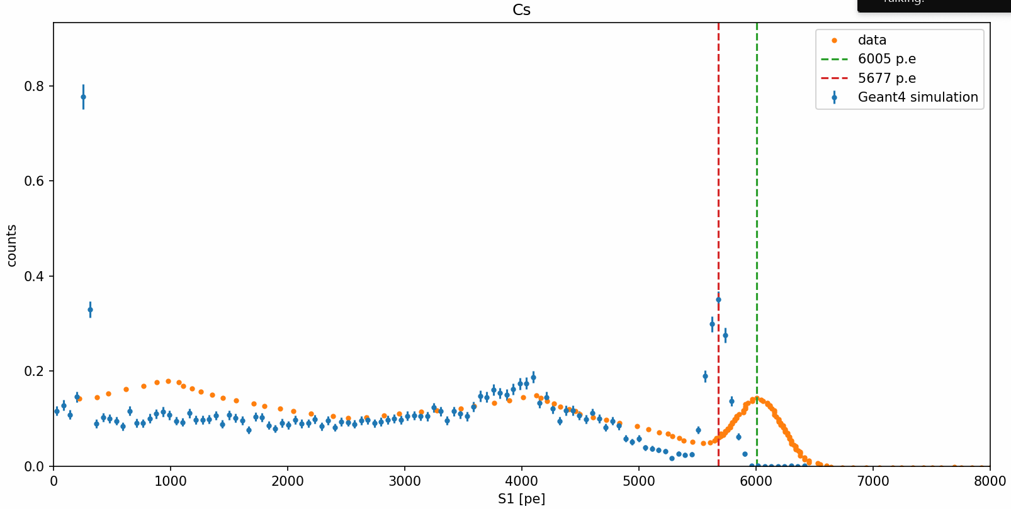
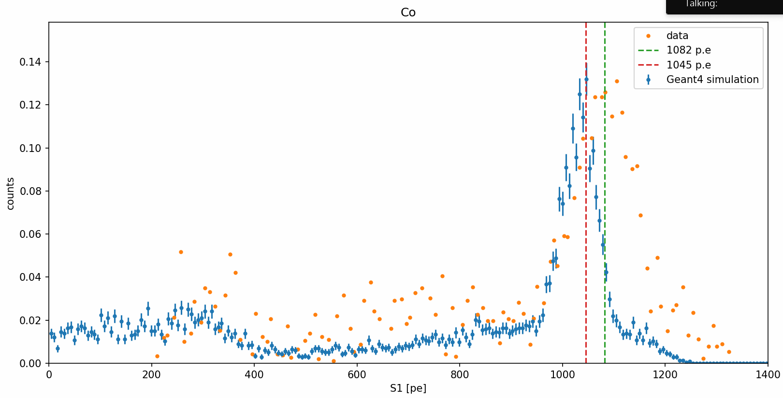
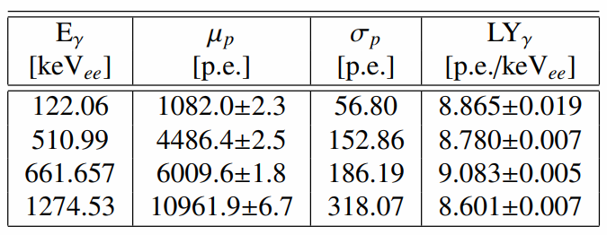
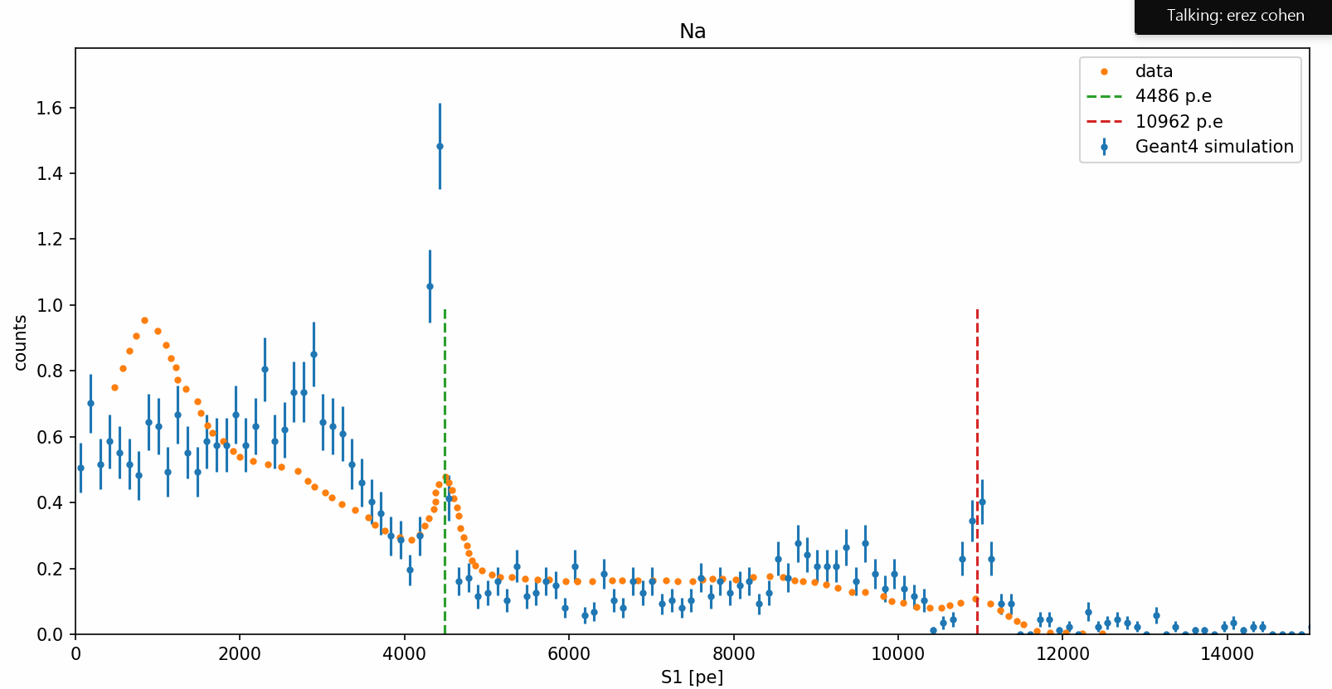
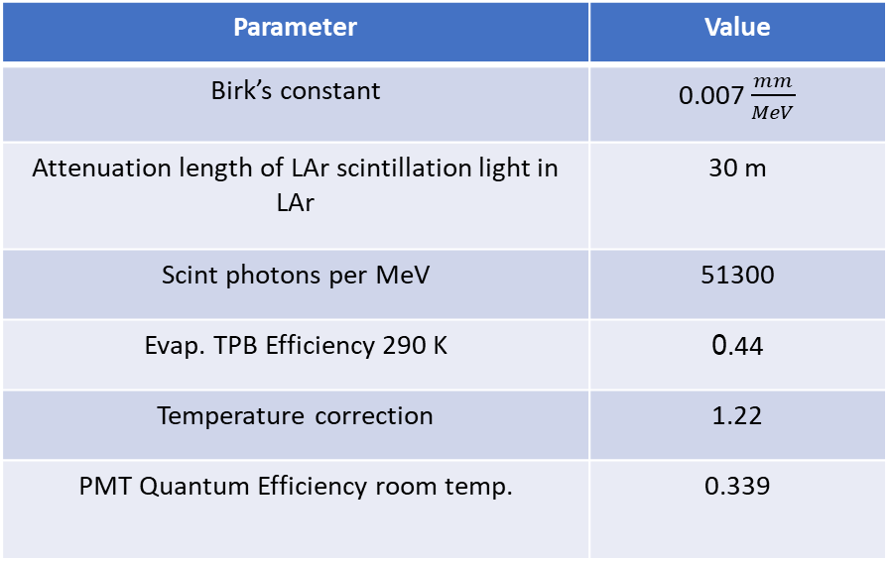
Parameter | Value
Birk’s constant | 0.007 $\frac{mm}{MeV}$
Attenuation length of LAr scintillation light in LAr | 30 m
Scint photons per MeV | 51300
Evap. TPB Efficiency 290 K | 0.44
Temperature correction | 1.22
PMT Quantum Efficiency room temp. | 0.339

Slide 21
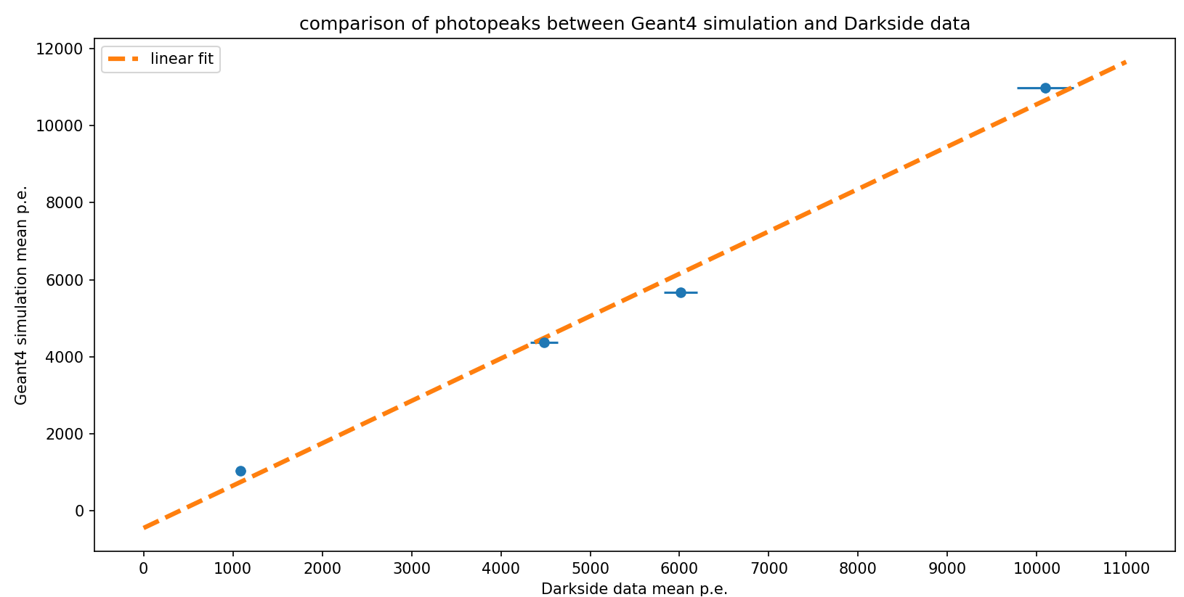
Here we can see Cs photopeak sits below the trend line, as expected since its light yield is ~4% higher than the other photopeaks

Slide 22
TPB efficiency and Birk’s constant were fit to the Na data, and we see some discrepancy in the Cs and Co data, however, they report an increased purity throughout the experiment, which changed the light yield and caused an increase of about 4% for the Cs data.
We can now move on to ARIS and try to fit neutron data

Slide 23
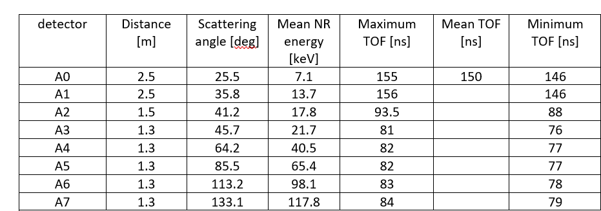
ARIS has 8 ND at 8 different angles, with corresponding nuclear recoil energies and TOFs summarized in the table below:

Slide 24
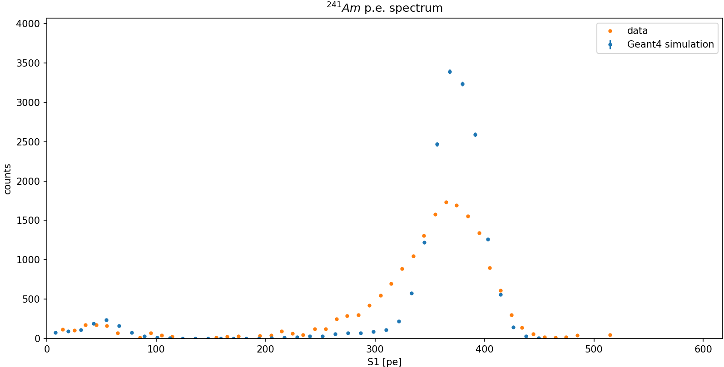
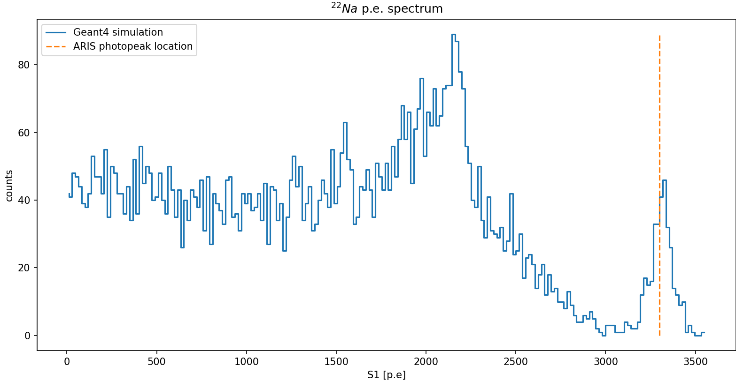
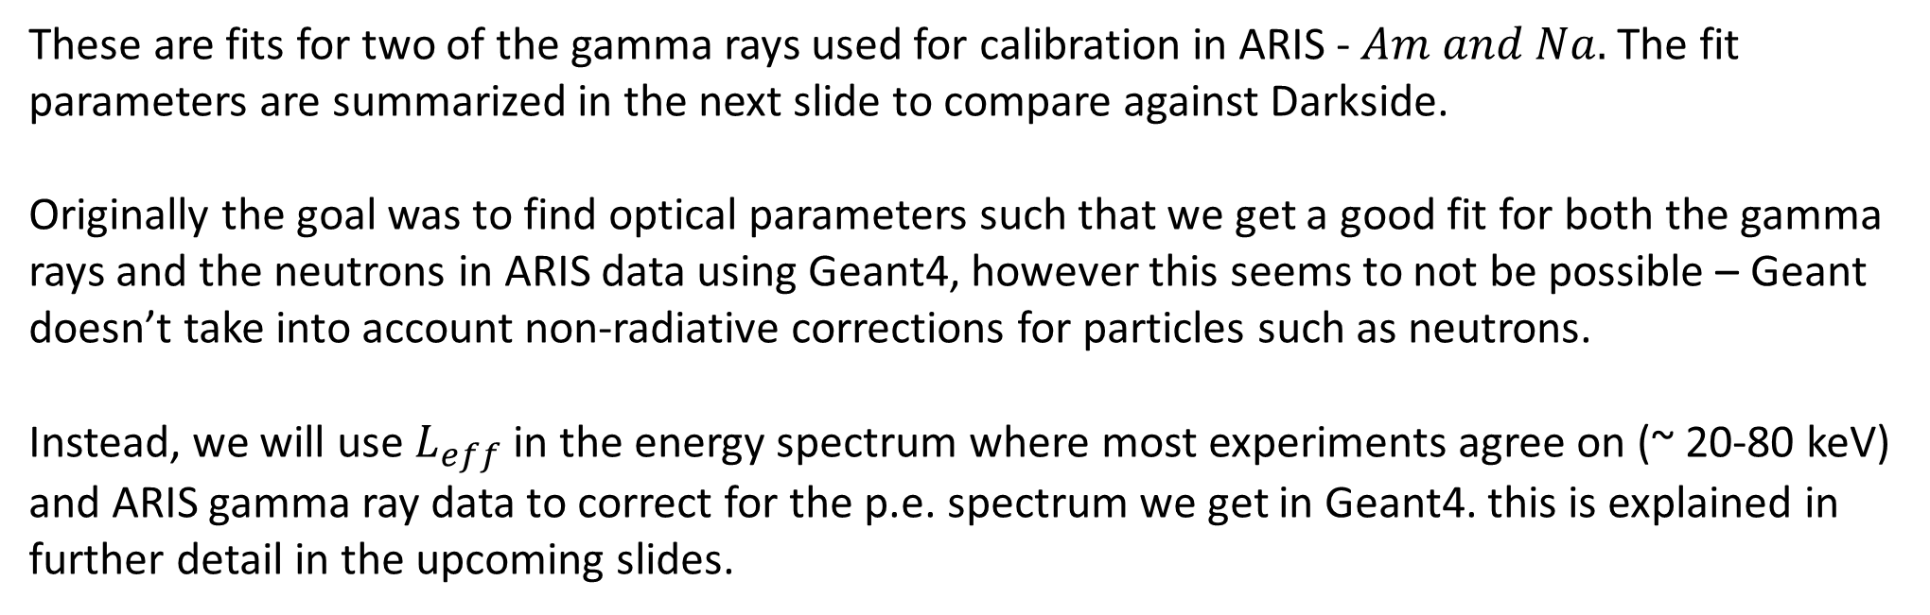
These are fits for two of the gamma rays used for calibration in ARIS - $Am and Na.$ The fit parameters are summarized in the next slide to compare against Darkside.
Originally the goal was to find optical parameters such that we get a good fit for both the gamma rays and the neutrons in ARIS data using Geant4, however this seems to not be possible – Geant doesn’t take into account non-radiative corrections for particles such as neutrons.
Instead, we will use $L_{eff}$ in the energy spectrum where most experiments agree on (~ 20-80 keV) and ARIS gamma ray data to correct for the p.e. spectrum we get in Geant4. this is explained in further detail in the upcoming slides.

Slide 25
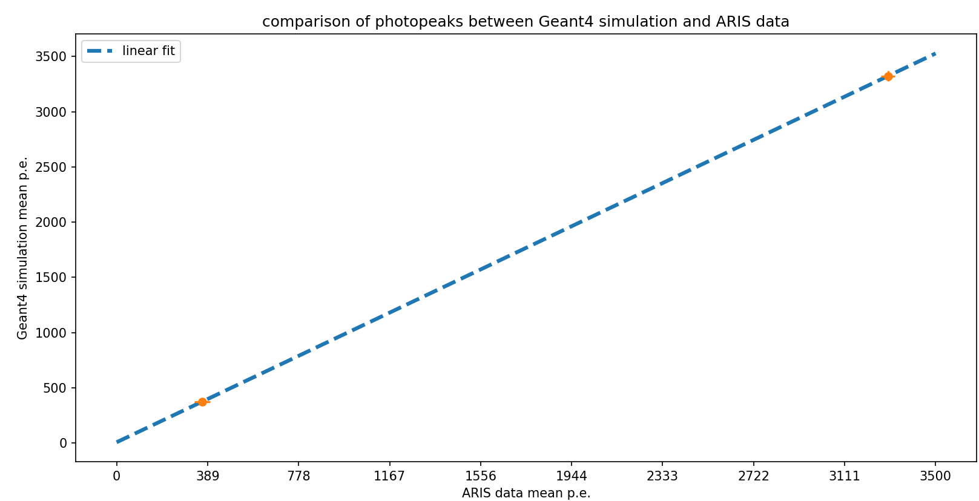

Slide 26
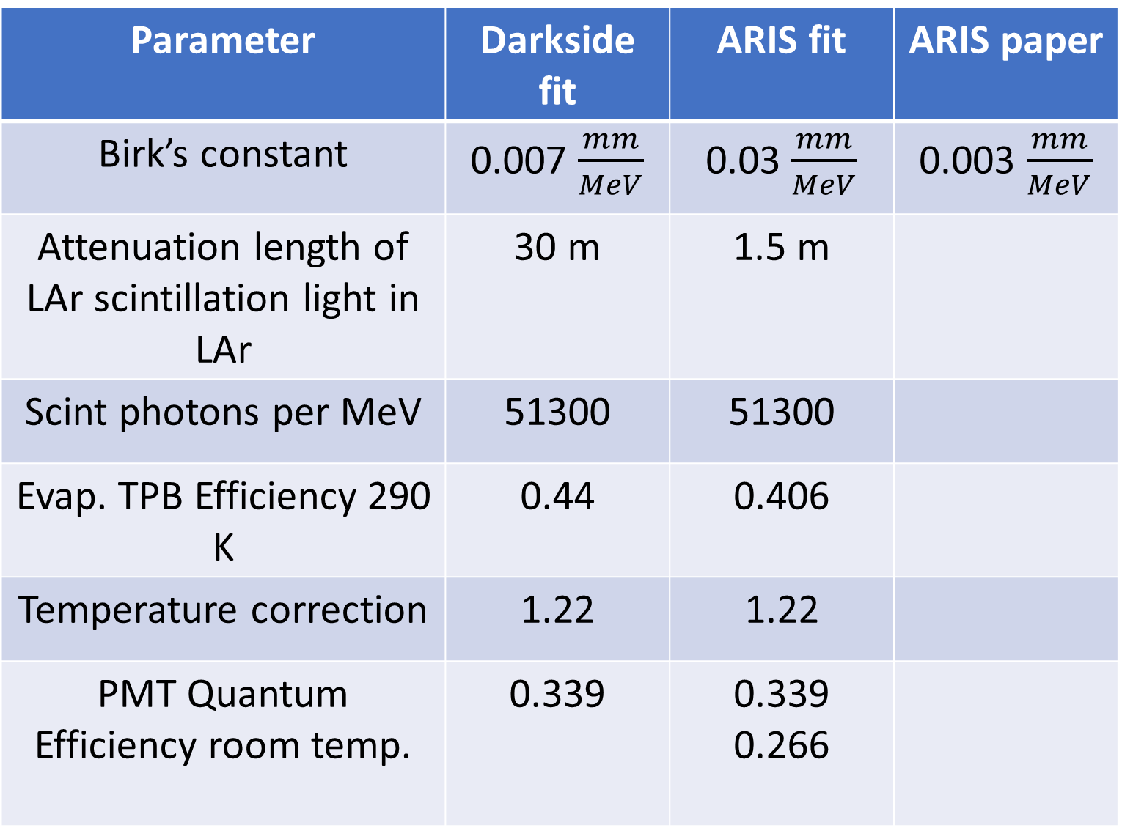
Parameter | Darkside fit | ARIS fit | ARIS paper
Birk’s constant | 0.007 $\frac{mm}{MeV}$ | 0.03 $\frac{mm}{MeV}$ | 0.003 $\frac{mm}{MeV}$
Attenuation length of LAr scintillation light in LAr | 30 m | 1.5 m
Scint photons per MeV | 51300 | 51300
Evap. TPB Efficiency 290 K | 0.44 | 0.406
Temperature correction | 1.22 | 1.22
PMT Quantum Efficiency room temp. | 0.339 | 0.339 0.266

Slide 27
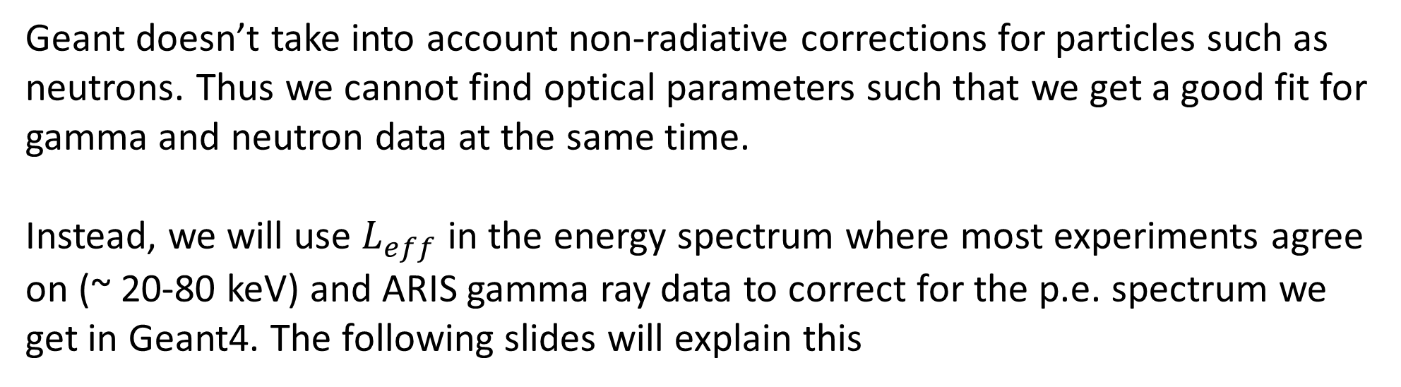
Moving forward
Geant doesn’t take into account non-radiative corrections for particles such as neutrons. Thus we cannot find optical parameters such that we get a good fit for gamma and neutron data at the same time.
Instead, we will use $L_{eff}$ in the energy spectrum where most experiments agree on (~ 20-80 keV) and ARIS gamma ray data to correct for the p.e. spectrum we get in Geant4. The following slides will explain this
$$N\left(p.e.\right)\left[i\right]=51300 ∗\frac{E_{nr}}{1MeV} ∗(k_{B},L_{attn}…)$$

Slide 28


Slide 29


Slide 30


Empirical data showing the relative light yield from nuclear recoil to a reference gamma ray

Slide 31

For example, We fire a neutron at the LAr target, and get a recoil nucleus with 50 keV kinetic energy. This is within the energy range where all experiments agree so we can use the $L_{eff}$ correction, which tells us that the number of optical photons produced by this nuclear recoil should be
$N_{correct}≈ 0.25×\#photons produced by 50 keV gamma ray$
Using our Geant4 simulation which is calibrated to ARIS experiment data, we know how many photons are produced by a 50 keV gamma ray – lets call this $N_{gamma}.$
Thus the number of photons that should be produced by the nuclear recoil is
$N_{gamma}×0.25$.
In our Geant4 simulation we see some other number of photons produced, call it $N_{nuc,sim}$. We also see a number of detected photoelectrons, $N_{pe}$ which depends on the optical coverage.
We can now make the correction $N_{pe}→N_{pe}^{∗}=N_{pe}×\frac{N_{gamma}×0.25}{N_{nuc,sim}}$

Slide 32

Using 0.25 constant $L_{eff}$ we get a mismatch from A5 onwards, which is expected since ARIS recorded a rise in $L_{eff}$ in these higher nuclear recoil energies. The following 2 slides show the corrected neutron induced scintillation fits against ARIS data. In the next 2 we use the measured $L_{eff}$ per scattering angle.

Slide 33





Slide 34





Slide 35





Slide 36





Slide 37


Slide 38


Extracting correction for $N_{p.e.}$

Slide 39


